Slide 1

The Leader of the All business and personal presentation template ever

Slide 2
New Regents’ Initiatives to Improve Student Access to Higher Education
Melanie Heath
Asst. Commissioner,
Strategic Communications
Dr. Julie Hartley
Asst. Commissioner,
Outreach & Access

Slide 3
Increase the educational attainment of Utahns
to enhance their overall quality of life,
and to meet Utah’s current and future workforce needs.
Affordable Access
Timely Completion
Research & Workforce
Capacity & Growth
Regent Work Groups
Utah College Acceptance Letter
Statewide Data /Tech. Strategy
High demand, undersupplied occupations
Student Aid and Tuition Policy
Mental Health Recommendations
Improve Information to Students on Workforce Options
StepUp Schools
Student Transfer
Strategic Communications Plan

Slide 4
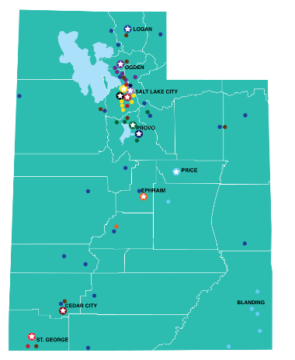
92% of Utah students stay in state for college
Notes:
Souce: Class of 2016 State High School Feedback Report

Slide 5

Barriers: Lack of College Knowledge
College readiness and under-preparation
Attending high schools without a college-going culture
Underrepresented populations especially vulnerable to not knowing how to get admitted to college.
National anxiety about admissions, student loans, etc.
Difficulty even contemplating a college application.

Slide 6
The Attainment Gap
Percentage of students graduating within 8 years
NCES Condition of Education 2015 (https://nces.ed.gov/programs/coe/pdf/coe_tva.pdf)

Slide 7
StepUp Schools
Notes:
StepUp Schools is our targeted outreach effort to first-generation, low-income, and other populations. Partner schools receive tailored outreach, and we are using data to measure progress and to see the impact of our efforts.

Slide 8

StepUp to Higher Education
StepUp Utah Scholars
Concurrent enrollment
Regents’ Scholarship
Utah College Application Week
FAFSA Completion Nights
Notes:
StepUp to Higher Education is the outreach arm for several college awareness and readiness programs run out of our office, including SUUS, CE, RS, UCAW, and FAFSA Nights. With all of these statewide outreach efforts, it’s sometimes hard to measure impact and to know that your programs are getting to the students who need them the most.

Slide 9
How can we do outreach in a more targeted, data-driven way, to get to the students who would benefit the most from our programs?
Notes:
So we asked ourselves a question: how can we do outreach in a more targeted, data-driven way, to get to the students who would benefit the most from our programs, such as low-income students, first-generation, and other populations?

Slide 10
StepUp Schools Initiative
Targeted outreach to first-generation, low-income and other historically underrepresented student populations.
Partner schools to receive tailored outreach, counselor training, and grants.
Data-driven approach to baseline and measure year-to-year progress.
Notes:
StepUp Schools is our targeted outreach effort to first-generation, low-income, and other populations. Partner schools receive tailored outreach, and we are using data to measure progress and to see the impact of our efforts.

Slide 11
School Selection Based on Data
% qualifying for Free and Reduced Lunch
% non-white
% FAFSA completions
% enrolling in college
Notes:
Looked at all Utah high schools and ranked them based on these four indicators.

Slide 12
16 High Schools
Granite District | Hunter |  | Ogden District | Ben Lomond
 | Kearns |  |  | Ogden
 | Granger |  | San Juan | San Juan
 | Cyprus |  | Millard | Millard
 | Cottonwood |  | Box Elder | Bear River
 | Taylorsville |  | S. Sanpete | Gunnison Valley
Salt Lake District | SLCSE |  | Washington | Dixie
 | East
 | West
Notes:
Based on that ranking, 16 high schools rose to the top.

Slide 13
19 “Feeder” Jr. High Schools
Granite District | Hunter |  | Salt Lake District | Bryant Middle
 | Granite Park |  |  | SLCSE
 | Valley |  |  | Clayton Middle
 | West Lake |  |  | Glendale Middle
 | Kennedy |  |  | Northwest Middle
 | Eisenhower |  | Ogden District | Highland
 | Hunter |  |  | Mound Fort
 | Jefferson |  |  | Mount Ogden
 | Bonneville |  | San Juan | Albert Lyman Middle
 | Scott Matheson |  | Millard | Fillmore Middle
 | Bennion |  | Washington | Dixie Middle
 | Kearns
Notes:
We also thought it was important to set the college going expectation early, so we extended our reach to 19 of their feeder junior high schools.

Slide 14
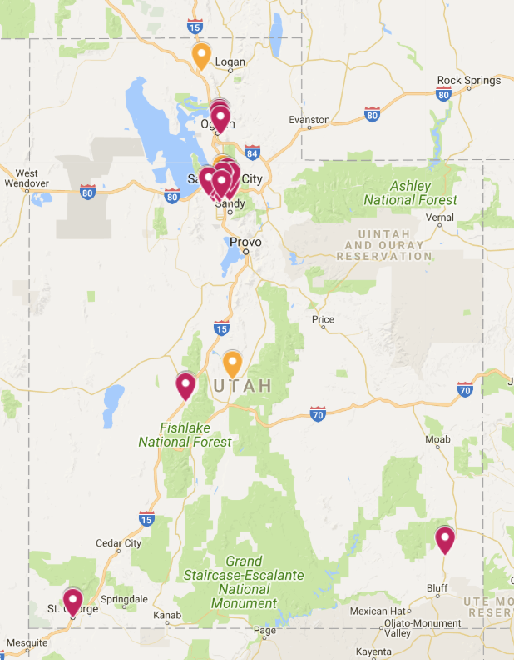
Notes:
As you can see, we lucked into the fact that while concentrated along the Wasatch front, our partner schools are spread out across the state. Julie and I have spent the last few months criss-crossing the state and meeting with school administrators and counselors to talk about our programming, understand what college readiness efforts they currently have in their schools, and to determine where we can help fill in the gaps. All 35 schools were enthusiastic about signing on. We have several MOUs in place, and are anticipating all to be signed before the start of the school year.

Slide 15
Purpose of StepUp Schools
Increase college-knowledge of students in partner schools
Help students be better prepared for college
Help students get in the door to college
Notes:
The purpose of StepUp Schools is three-fold:

Slide 16
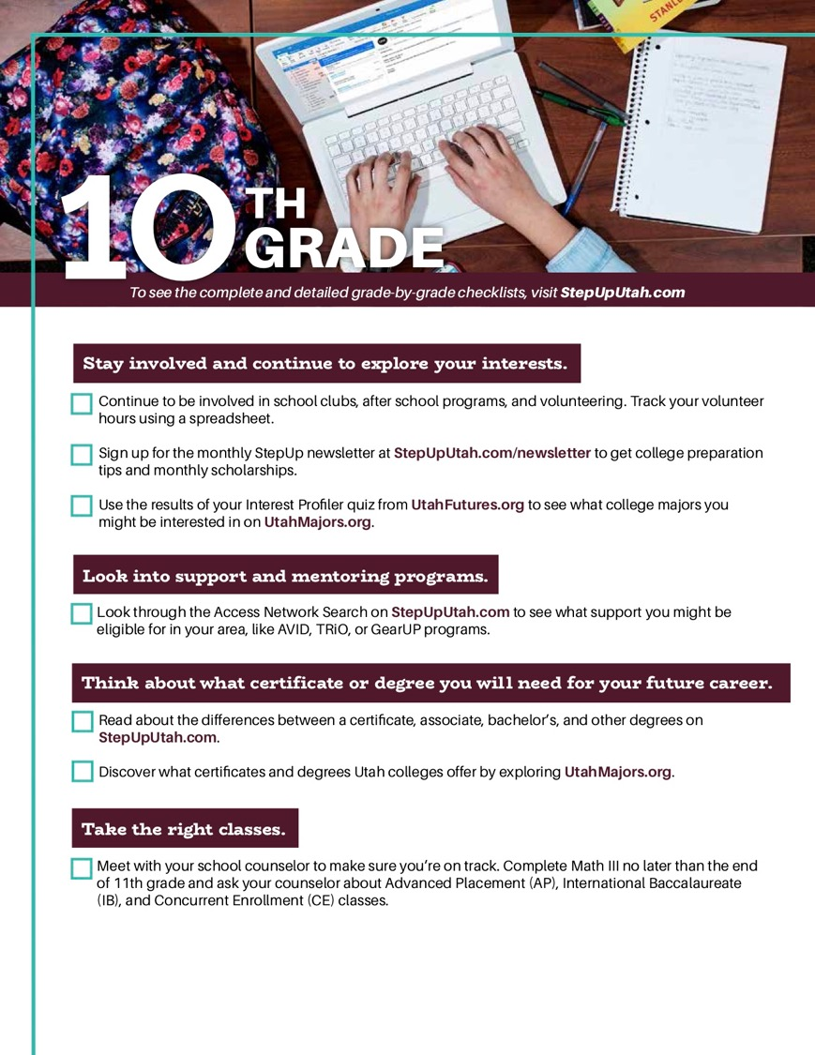
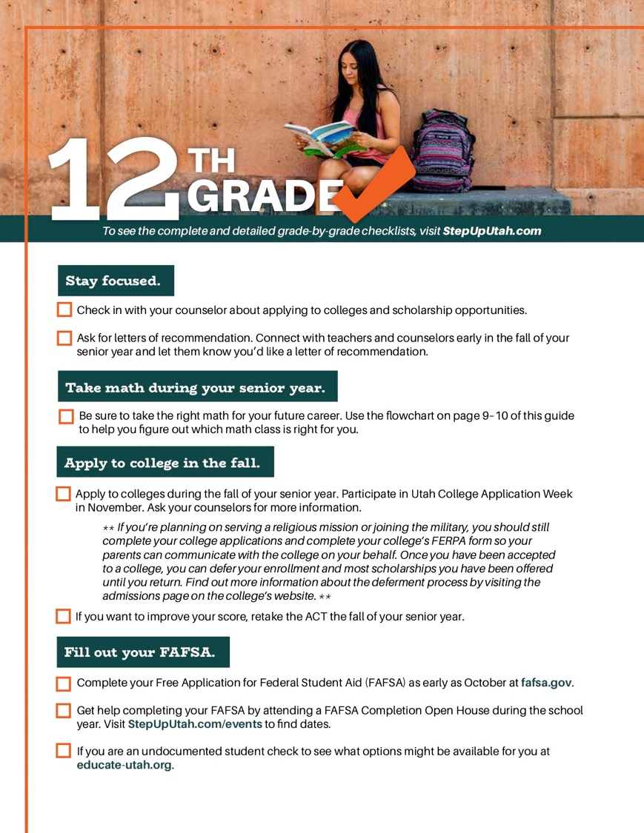
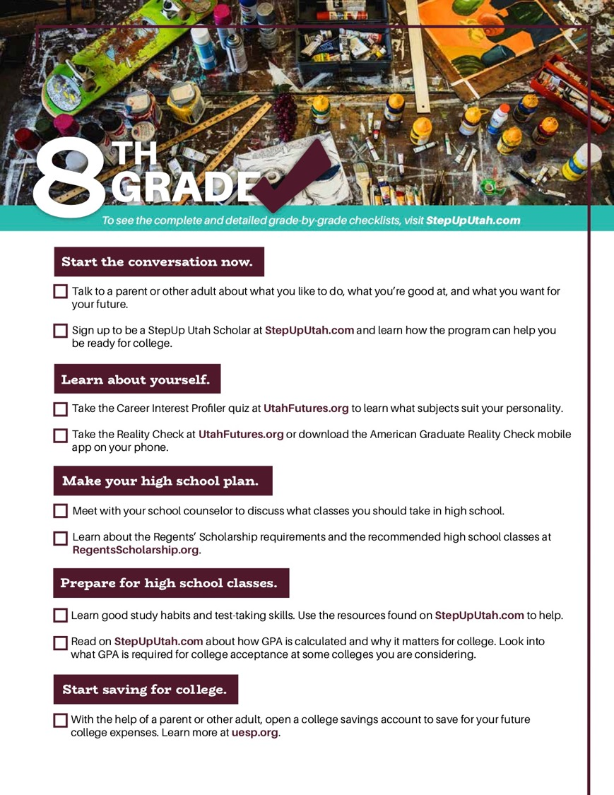
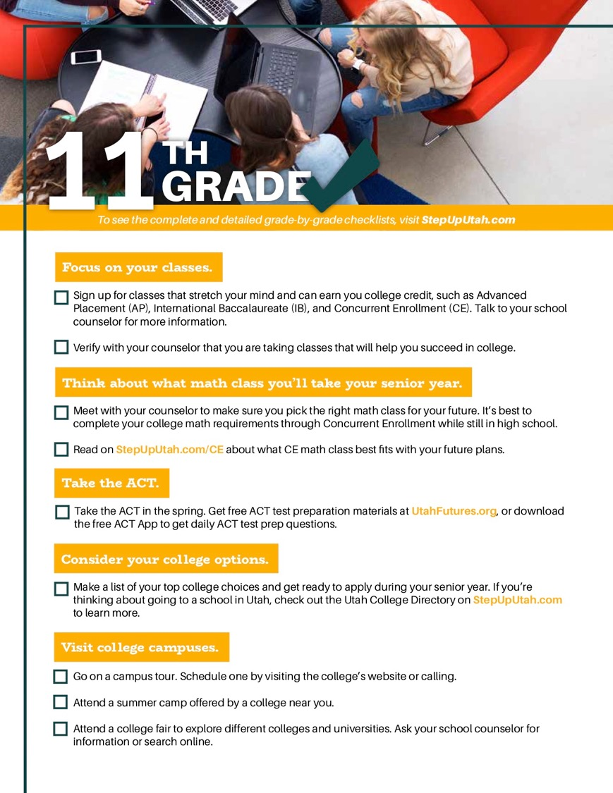

Jr. High
StepUp Utah Scholars
Resources for 7-8th grade CCR meetings
Regents’ Scholarship outreach
Notes:
In junior highs, StepUp Schools is really focused in three areas:
StepUp Utah Scholars, which is a college-awareness program for 8th grade students to get them thinking about college in their future, and help them plan how to do high school right so they’re prepared when the time comes. They are given a presentation in 8th grade which introduces the checklists. These grade by grade checklists tell them what they need to do in each grade to be prepared for college. If they complete a set number of tasks from the checklist, they’re eligible for a medallion upon high school graduation. Many schools already have this program, but we are working with some partner schools to implement it.
Each student in either 7/8 grade has a college and career-readiness meeting with their counselor, and ideally, their parent. We will be providing resources for counselors to use in these meetings to encourage students to think about college and how they need to do high school right to prepare. Some are RS materials and the College Guide, our evergreen publication.
As you know, the RS is a four-year scholarship, so it’s important for students to be prepared to take the right classes in high school. We’ll be doing RS outreach in these schools

Slide 17
High School
Concurrent enrollment (CE) recruitment
  Train counselors to identify students who are not self-selecting into CE classes, but have a high likelihood of being successful
    Using data such as GPA, ACT scores, Lexile scores, teacher recommendations, etc.
  Notify these students that they are qualified and encouraged to take a CE class
The college enrollment rate is more than twice as high for low-income students who have taken CE, when compared to low-income students who have not taken CE.
Notes:
We know that CE is particularly impactful for low income students, in fact, the college enrollment rate is more that 2x as high for LI students who have taken CE, compared to low income students who have not taken CE. So we want to recruit students who are not self-selecting into CE classes to take it. We’ll train counselors to identify these students and encourage them to take a CE class.

Slide 18
High School
Regents’ Scholarship on-track notification and outreach
  Train counselors to identify students who are on-track to qualify for the Regents’ Scholarship, and encourage these students to apply
  Additional outreach support, including optional 1:1 advising with scholarship specialists
Notes:
Many students aren’t aware that they actually qualify for the RS. So we will again train counselors to identify students who are on-track to qualify for the RS, and encourage them to stay on-track and apply. We’re also wanting to implement additional outreach support, including optional 1:1 advising with scholarship specialists.

Slide 19
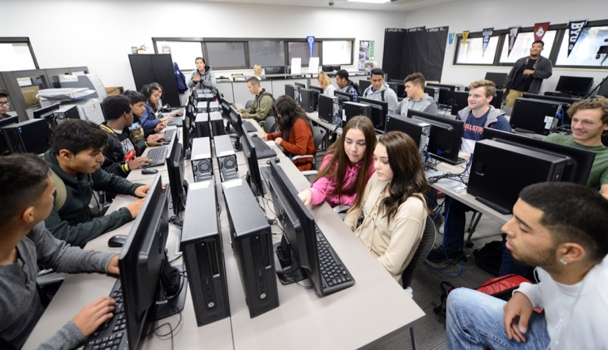
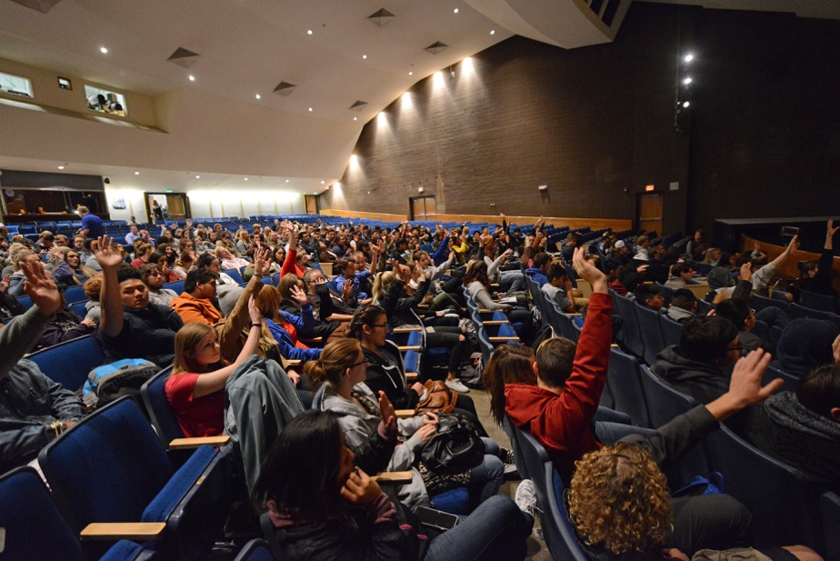
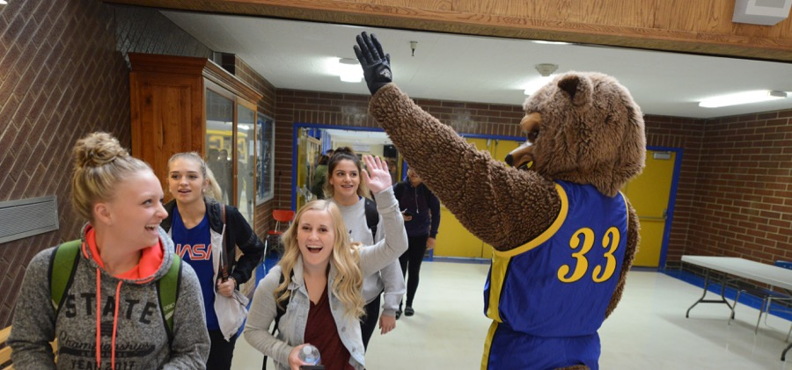
High School
Utah College Application Week, including activities for younger grades
Notes:
UCAW is a program that is currently statewide and has been hugely successful. The goal is to provide every high school senior the opportunity to apply to college during the school day with help from trained volunteers and school staff. Our partner schools will also implement college awareness activities for younger grades, to help get them excited about college and looking forward to their UCAW event their senior year as well.

Slide 20
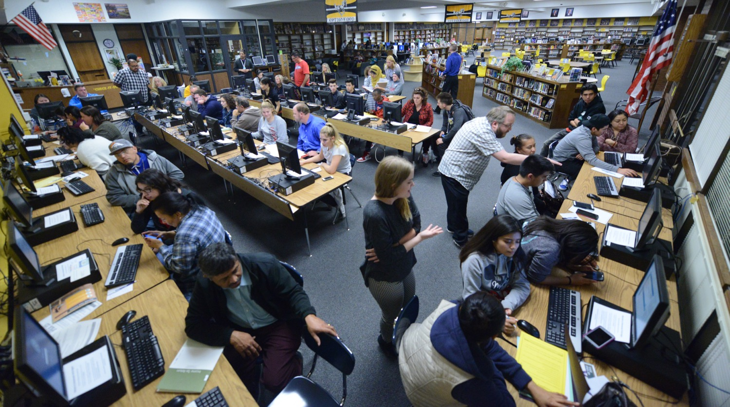
FAFSA Completion Open Houses
Notes:
Despite recent improvements, Utah has always had worst-in-the-nation FAFSA completion rates. We are working to change that. UHEAA outreach holds FAFSA Completion open houses throughout the state already, to give students and parents the opportunity to fill out the FAFSA with the help of a qualified outreach officer. In our partner schools, we are aligning the programming of these events with College Application Week, to try to cement in students’ minds that “applying to college” means filling out an admissions application as well as a financial aid application.

Slide 21
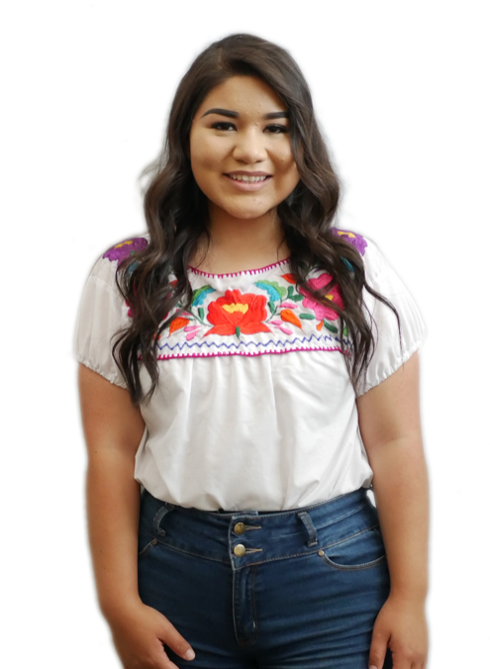
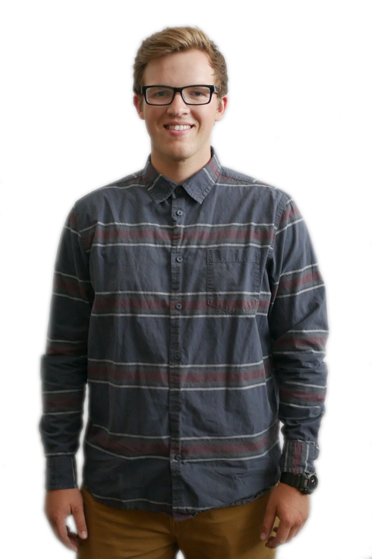
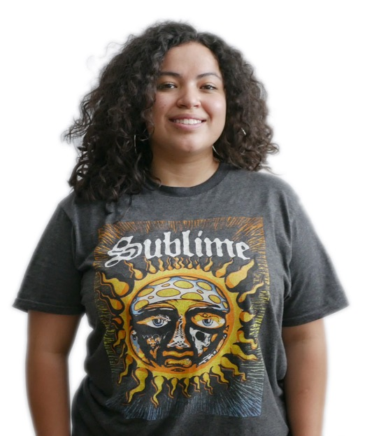
StepUp Ambassadors
Notes:
Brand new Ambassador program will be placed in select partner schools to actively engage high schools students and help prepare them for college success. Different from other Ambassador programs, they won’t be recruiting for their college, but will promote the importance of going to college in general. The implementation of this program will look a bit different in each school, but will include either an after-school program or a presence during the school day, during lunch for example, to engage with students about college and help with scholarship applications, questions about college, etc. Here are a few of our mentors:
Leslie Salamanca-Sotelo- Freshman, University of Utah, HS: Wasatch High School, Fun Facts: First-generation, Mexican-American student, former LIA student leader passionate about making a difference for her community.
Dallas Carter- Junior, Weber State University, HS: Syracuse High School, Fun Facts: Has done volunteer work in Guatemala and Peru, speaks Spanish, passionate about healthcare, experience working with elementary and middle school students.
Nubia Gutierrez- Freshman, Utah State University, HS: Ben Lomond, Fun Facts: First-generation student from El Salvador, former Upward Bound student

Slide 22
High School
Proactive communications efforts to remind students of deadlines, events, checklist items, etc:
  Text messaging Social media
  E-newsletter
  Mailers

Slide 23
Support: College Readiness Grants
$5,000 college readiness grant for partner high schools to support efforts such as:
  College readiness activities and events
  Concurrent enrollment costs for low income students
  Professional development including travel offset
$1,000 college readiness grant for partner junior high schools to support college readiness activities and events
Notes:
We want to make sure we support schools in their existing college readiness efforts, as well as give them the resources to increase and improve those efforts. We developed a grant program for our partner schools. The High schools get an additional funds. We know there are financial barriers to taking CE, particularly for low-income students, such as textbook costs, application fees, etc. So in addition to college readiness activiti4es and professional development incentives, we made these funds available to offset those barriers for students.

Slide 24
Support: Professional Development
Data training for Regents’ Scholarship and CE efforts
Training on new Regents’ Scholarship qualifications
Implementation of programs such as UCAW, FAFSA Nights, and StepUp Utah Scholars
USHE Counselor Conference: Best practices to create a college-going culture
Digital communications training (social media, websites, etc)
Notes:
Professional development for counselors is a crucial piece of this initiative, as we rely heavily on counselors for data, student notification, and implementation of existing programs. So we will provide one-on-one training for counselors and adminstrators in our partner schools so that they are prepared to support their students in this way. We will also get them all together for the USHE counselor conference, our annual conference for counselors, to help facilitate conversations and share best practices.

Slide 25
Goals of Initiative
Have benchmarks, working to set school-specific goals in each of the following areas:
  Increase students self-selecting into CE classes
  Increase students qualifying for the Regents’ Scholarship
  Increase students applying to college
  Increase students applying for financial aid
  Increase students enrolling in college
Notes:
As stated before, this initiative is really unique in that it is based on data, progress is measured, and goals are set. We have benchmarks in each of these categories for each school, and we are working with each school to identiy specific % increase goals for each of these categories. With the ultimate goal of getting more students enrolling in college.

Slide 26

Utah College Acceptance Letters

Slide 27
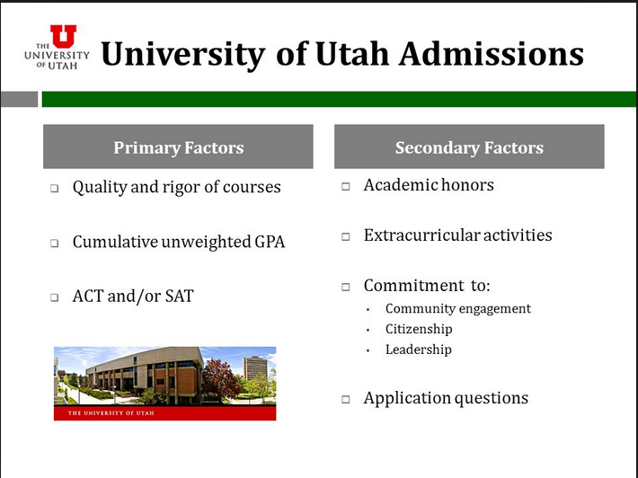
Open Admissions vs. Selective

Slide 28

Idaho

Slide 29
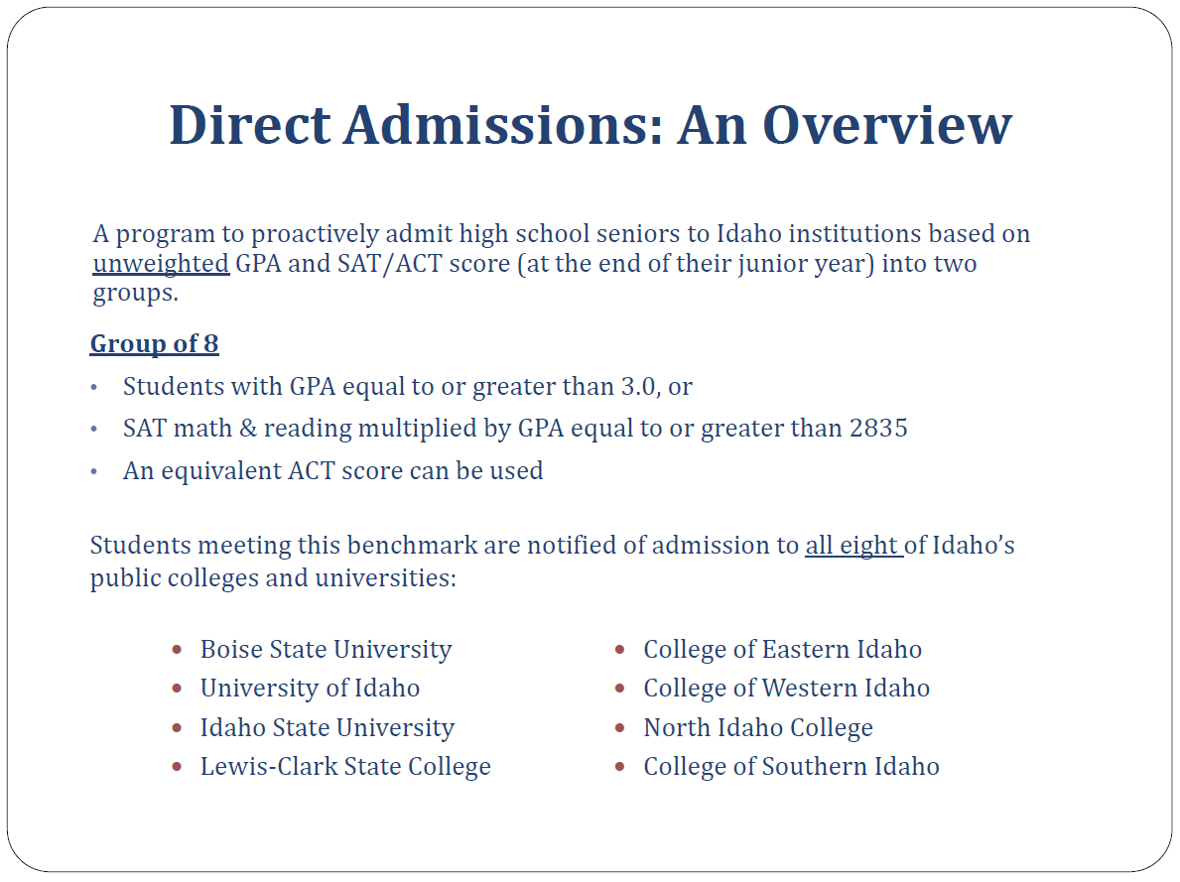

Slide 30
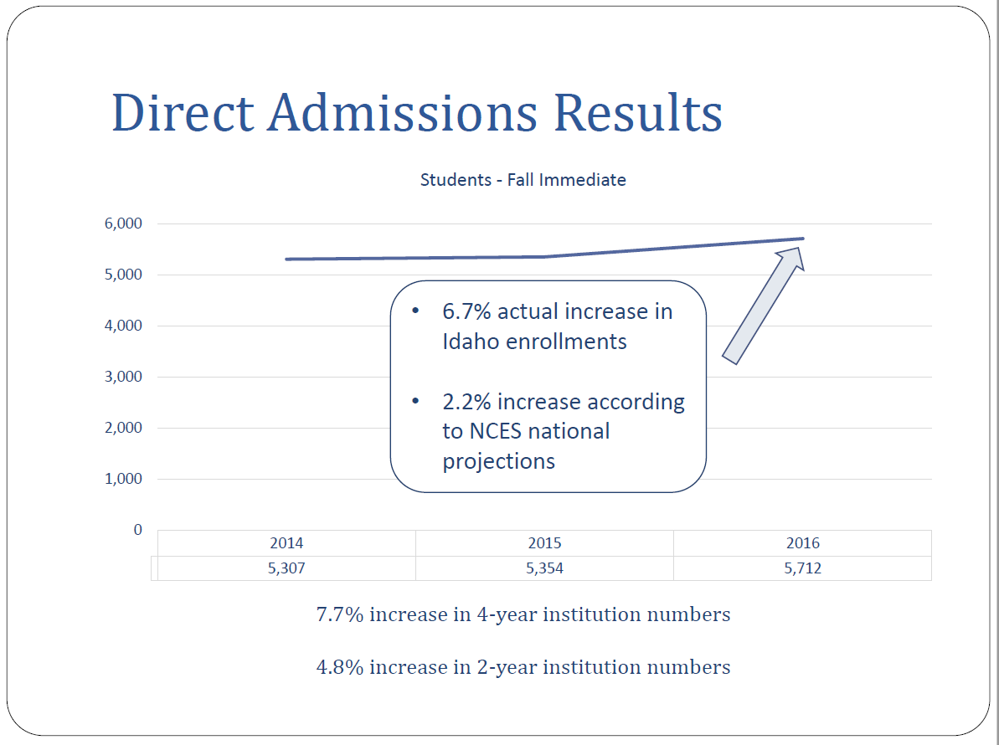

Slide 31
Goals of Initiative
Promote college-going and show students they all have access to higher education
Connect students and families with specific colleges & help them really consider their options based on good, personalized information
Ease the anxiety over college applications, admissions, and costs
Ultimate goal: increase college enrollment by 5% the year following high school graduation; increase college enrollment to 75% of high school graduates within 5 years of graduation.

Slide 32
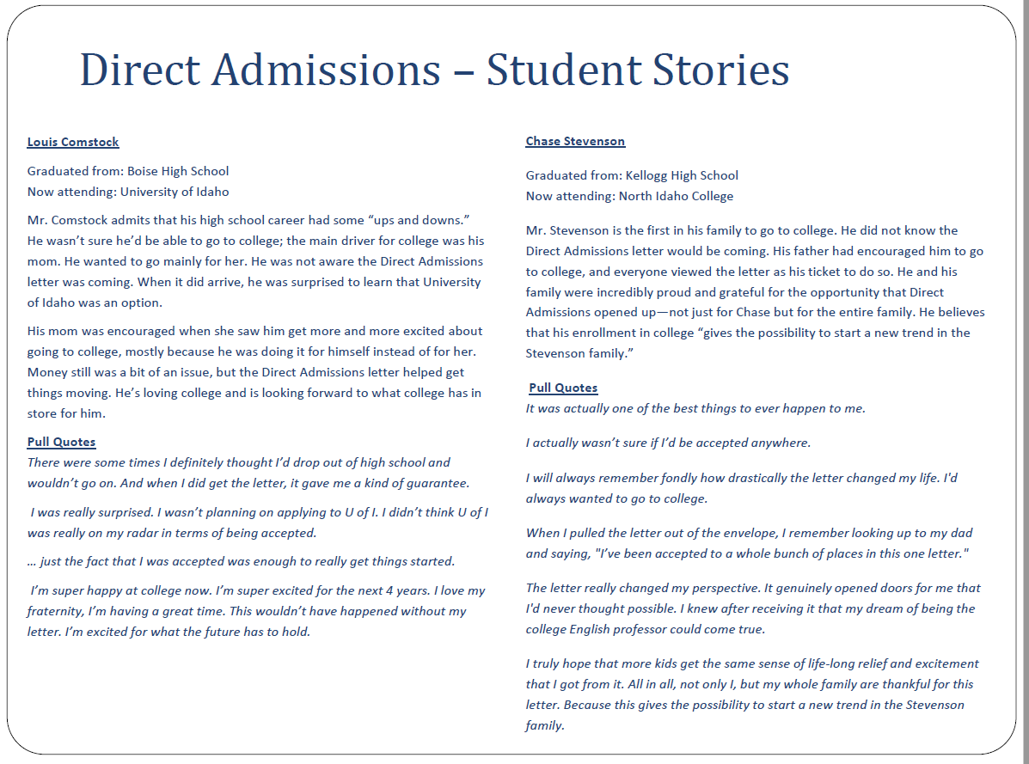

Slide 33
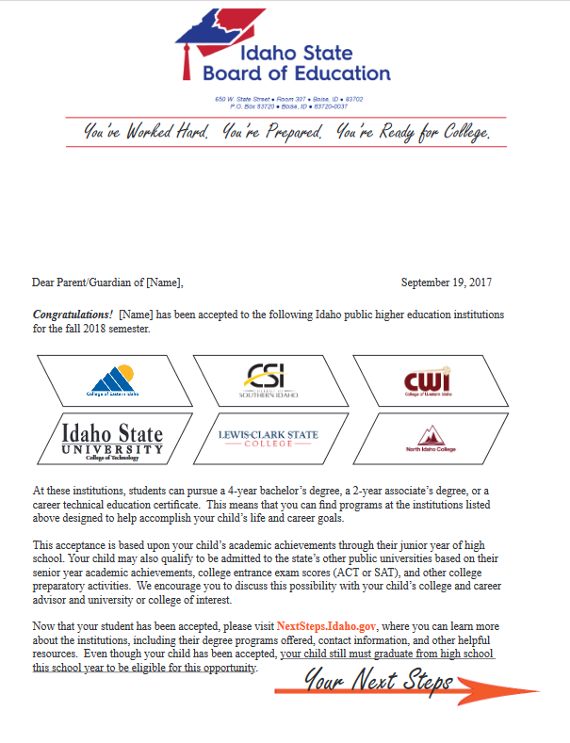
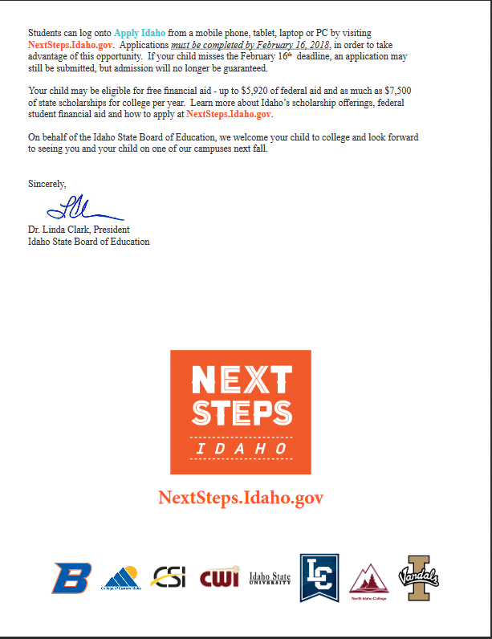
Idaho Parent’s Letter

Slide 34
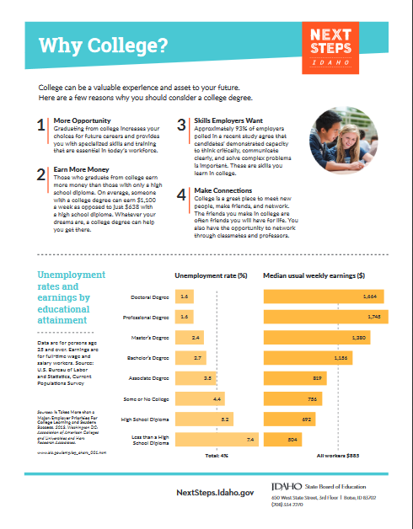
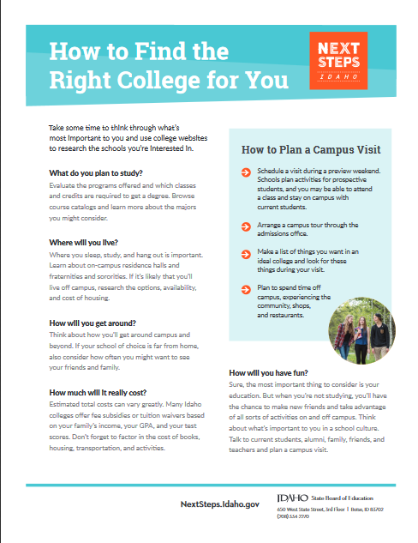
Inserts

Slide 35
Understanding the impact of tuition and financial aid on student access and affordability

Slide 36
Student Aid & Tuition Policy Evaluation & Redesign
Primary Goal: Baseline study that:
  Captures the cost/benefit of discounted tuition to the state
  Determines the multiplier effect of nonresident student graduates to USHE institutions and the state
  Provides recommendations for policy and performance metrics on affordability.

Slide 37
Timeline
August—Scope the study
September –Spring 2019: Completion of the study
Summer 2019—Present results of study to Regents and discuss next steps

Slide 38
The Leader of the All business and personal presentation template ever

