Slide 1
School Safety & Crisis Tip Line

Slide 2
What Is SafeUT?
The Utah Legislature created the statewide School Safety and Crisis Line in 2015 (SB0175) . In an effort to address school safety and reduce Utah’s suicide rate, SafeUT received additional funding during the 2018 Legislative Session to expand services to all institutions of higher education in Utah (HB 370).
SafeUT is a Crisis Chat Line and a School Safety Tip Line developed for all students in Utah, including higher education students. All 41 Utah K-12 school districts have adopted the use of the SafeUT app as well as all eight State sponsored Institutions of Higher Education.

Slide 3
What is SafeUT?
The SafeUT Commission continues to help develop and implement the program in Utah schools. The commission is represented by:
Utah Attorney Generals Office
Utah State Legislature
University of Utah Neuropsychiatric Institute (UNI)
Utah System of Higher Education
Utah State Office of Education
Utah System of Technical Colleges
University of Utah Health IT Department
Utah Department of Human Services

Slide 4
2019 LEGISLATIVE Session UPDATE HB 373 – Student Support Amendments

Slide 5
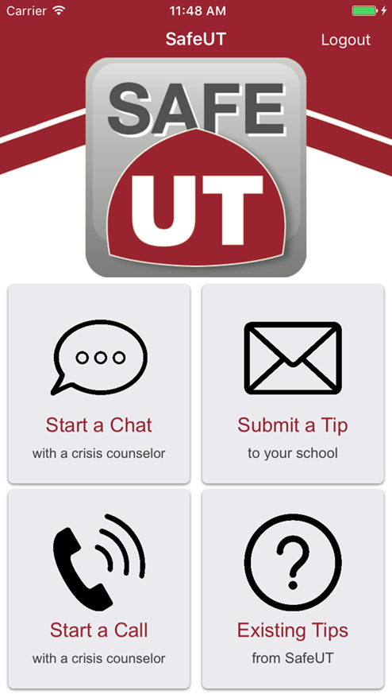
Services Provided
Users can submit:
Tip - Concerns (weapons, suicide threats, self-harm, drugs etc.) that are immediately sent to both SafeUT staff and the school to evaluate
Chat - Therapeutic dialogue through texting with a SafeUT Licensed Crisis Worker
Call – Therapeutic dialogue through a phone conversation with a SafeUT Licensed Crisis Worker

Slide 6
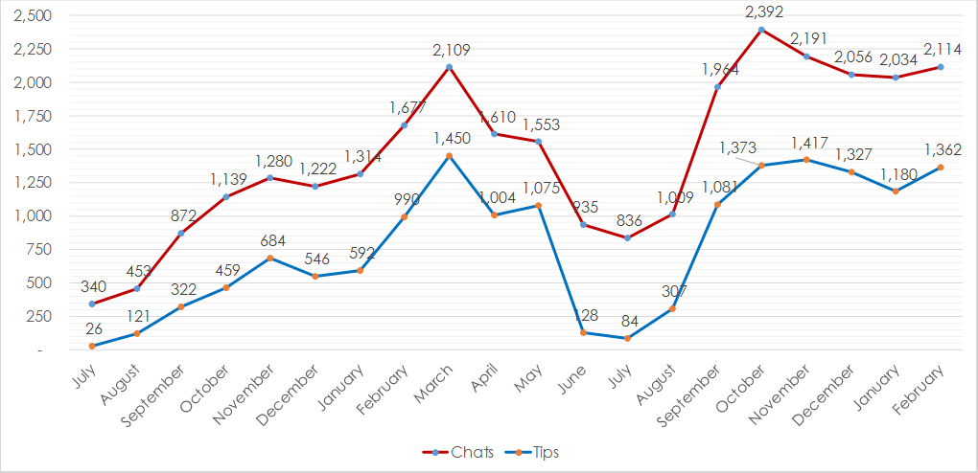
SafeUT utilization – Total Schools July 2017 – February 2019

Slide 7
SafeUT Higher Ed Utilization August 1, 2018 – March 24, 2019
Higher Ed Institution | Chats | Avg. Threads per Chat | Verified Tips | Verified Top Tip Topics
Dixie State University | 36 | 29 | 0 | N/A
Salt Lake Community College | 235 | 25 | 2 | Mental Health, Suicide
Snow College | 60 | 21 | 7 | Suicide, Mental Health, Depression, Act of Kindness
Southern Utah University | 38 | 43 | 1 | Suicide
University of Utah | 916 | 36 | 26 | Suicide, Mental Health, Dating Violence, Harassment
Utah State University | 195 | 27 | 5 | Mental Health, Eating Disorder, Harassment
Utah Valley University | 80 | 33 | 1 | Cutting
Weber State University | 40 | 22 | 5 | Mental Health, Suicide

Slide 8
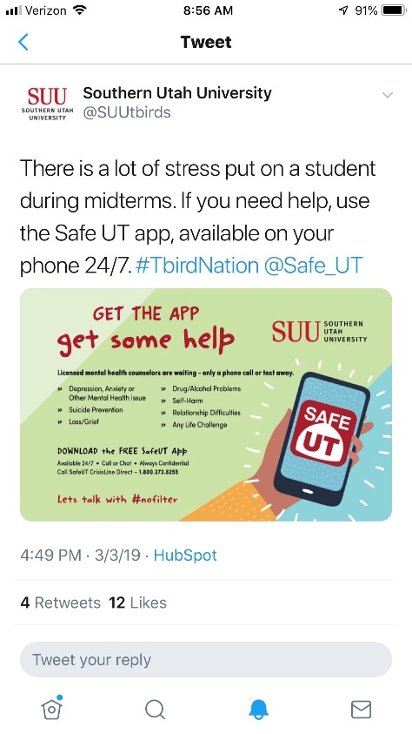
SafeUT higher ed marketing
College Banners
A Frames
Social Media
Higher Ed Events
U of U Plaza Fest
USU Day on the Quad
SUU “Paint the Town Red”
DSU Health Services Fair
U of U Wellness Fair
USU Mental Health Wellness Fair

Slide 9
SafeUT higher ed success stories

Slide 10
SafeUT higher ed success stories

Slide 11
SafeUT higher ed success stories
A VP of Student Service expressed his gratitude for SafeUT. He showed SafeUT an email conversation between himself and a student where he introduced the SafeUT app as a resource. The student proceeded to tell the VP that he was using it, chatting, and really getting the support and grounding techniques he needed. The student’s father thanked SafeUT profusely for saving his son’s life.

Slide 12
Questions?
SafeUT@hsc.utah.edu
801-587-8852

