Slide 1
Learn & Work In Utah
August 21, 2020

Slide 2
HB 5010 - Federal CARES Act funding created the new Learn & Work In Utah initiative
~$9 million for short term training
Talent Ready Utah
Utah System of Higher Education
Provides training for workers who are unemployed, underemployed or in vulnerable positions due to COVID-19

Slide 3
Program Details
Institution | Round 1 Funding | Potential Round 2 Funding
Bridgerland | $386,050.00 | $0.00
Dixie Tech | $397,042.00 | $0.00
Dixie State U | $711,700.00 | $170,025.00
Mountainland | $1,318,902.00 | $1,049,445.00
SLCC | $611,504.38 | $601,391.00
Snow | $900,650.00 | $117,812.00
SUU | $383,595.00 | $192,960.00
SW Tech | $249,489.55 | $32,000.00
Tooele Tech | $377,248.00 | $76,452.00
UB Tech | $148,000.00 | $0.00
U of U | $589,251.00 | $290,740.00
USU | $783,968.00 | $567,400.00
UVU | $841,732.00 | $699,500.00
Weber | $1,022,274.00 | $796,272.00
Total | $8,721,405.93 | $4,593,997.00
188 program proposals totaling over $15 million in requested funds
Awarded the first $8.7 million in program support to our institutions
$200,000 to Rumor Advertising Group to combine Learn & Work with IN UT campaign
Committee identified another potential $4.5 million in programming for additional CARES funding

Slide 4
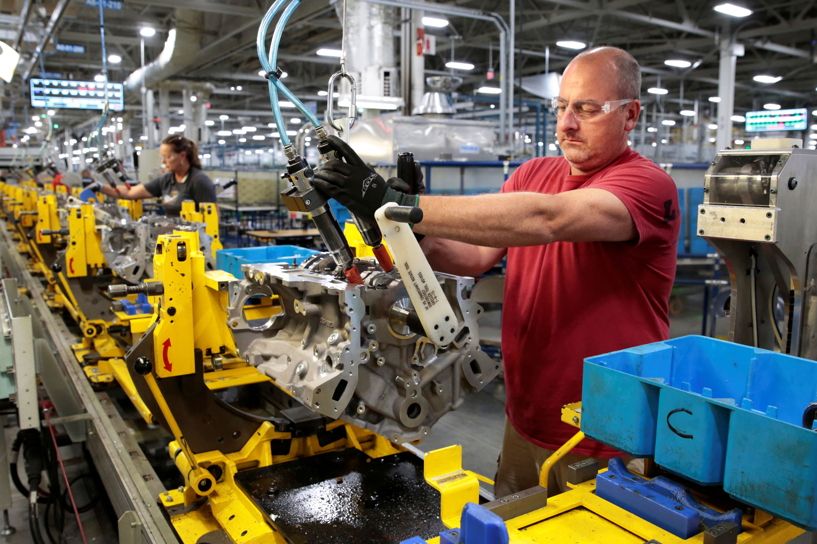
Programs Types:
Welding/CDL/Manufacturing/Automotive
Health Care
IT - short industry credentials & longer programs
Web design and support
Microsoft Office & digital tools for the remote work world
Graduate certificates – Cyber Security & Analytics
Training educators to transition to digital learning
Small business support
If all programs identified for funding fill we will support almost 10,000 students in gaining valuable workforce skills

Slide 5
Questions?

