Slide 1
Utah Board of Higher Education
August 21, 2020
Clay Christensen President

Slide 2
Student-Centered & Guiding Principles
Mountainland Technical College (MTECH) is committed to welcoming students back to campus and will promote a healthy environment using a combination of the Centers for Disease Control (CDC)-guided behavioral expectations (e.g., face coverings, social distancing) and an ethic of personal responsibility, enhanced facility cleaning protocols, and comprehensive communications.
At MTECH, we know that no plan is perfect, nor should it remain fixed indefinitely. We expect that our policy will evolve as the status of COVID-19, and our understanding of best practices, develops.
The cornerstone of MTECH’s reopening plan is the same which has governed our operations for three decades: ensuring the health and well-being of our students, faculty, staff, and visitors.

Slide 3
Timeline & Response
March 13: Announcement of temporary cessation of in-person instruction and introduction of online-only Instruction to begin March 18
March 23: Announcement of complete MTECH Closure beginning March 30
April 28: Notice of extension of closure, re-opening date set for June 1
June 1: Phase 1 Re-opening of MTECH and in-person instruction
August 3: Phase 2 of re-opening implemented

Slide 4
Early Operating Decisions
Students:
No tuition charged from March 16 until June 1
Canvas available for those interested in progressing
Close coordination with school districts for High School grading
Probationary contracts frozen
Graduation canceled
Counseling available (MTECH and/or SafeUT Counselors)
Faculty & Staff:
Curriculum updates and modifications
Individual work-plans for all employees
Professional development training
Counseling available (MTECH and/or SafeUT Counselors)

Slide 5
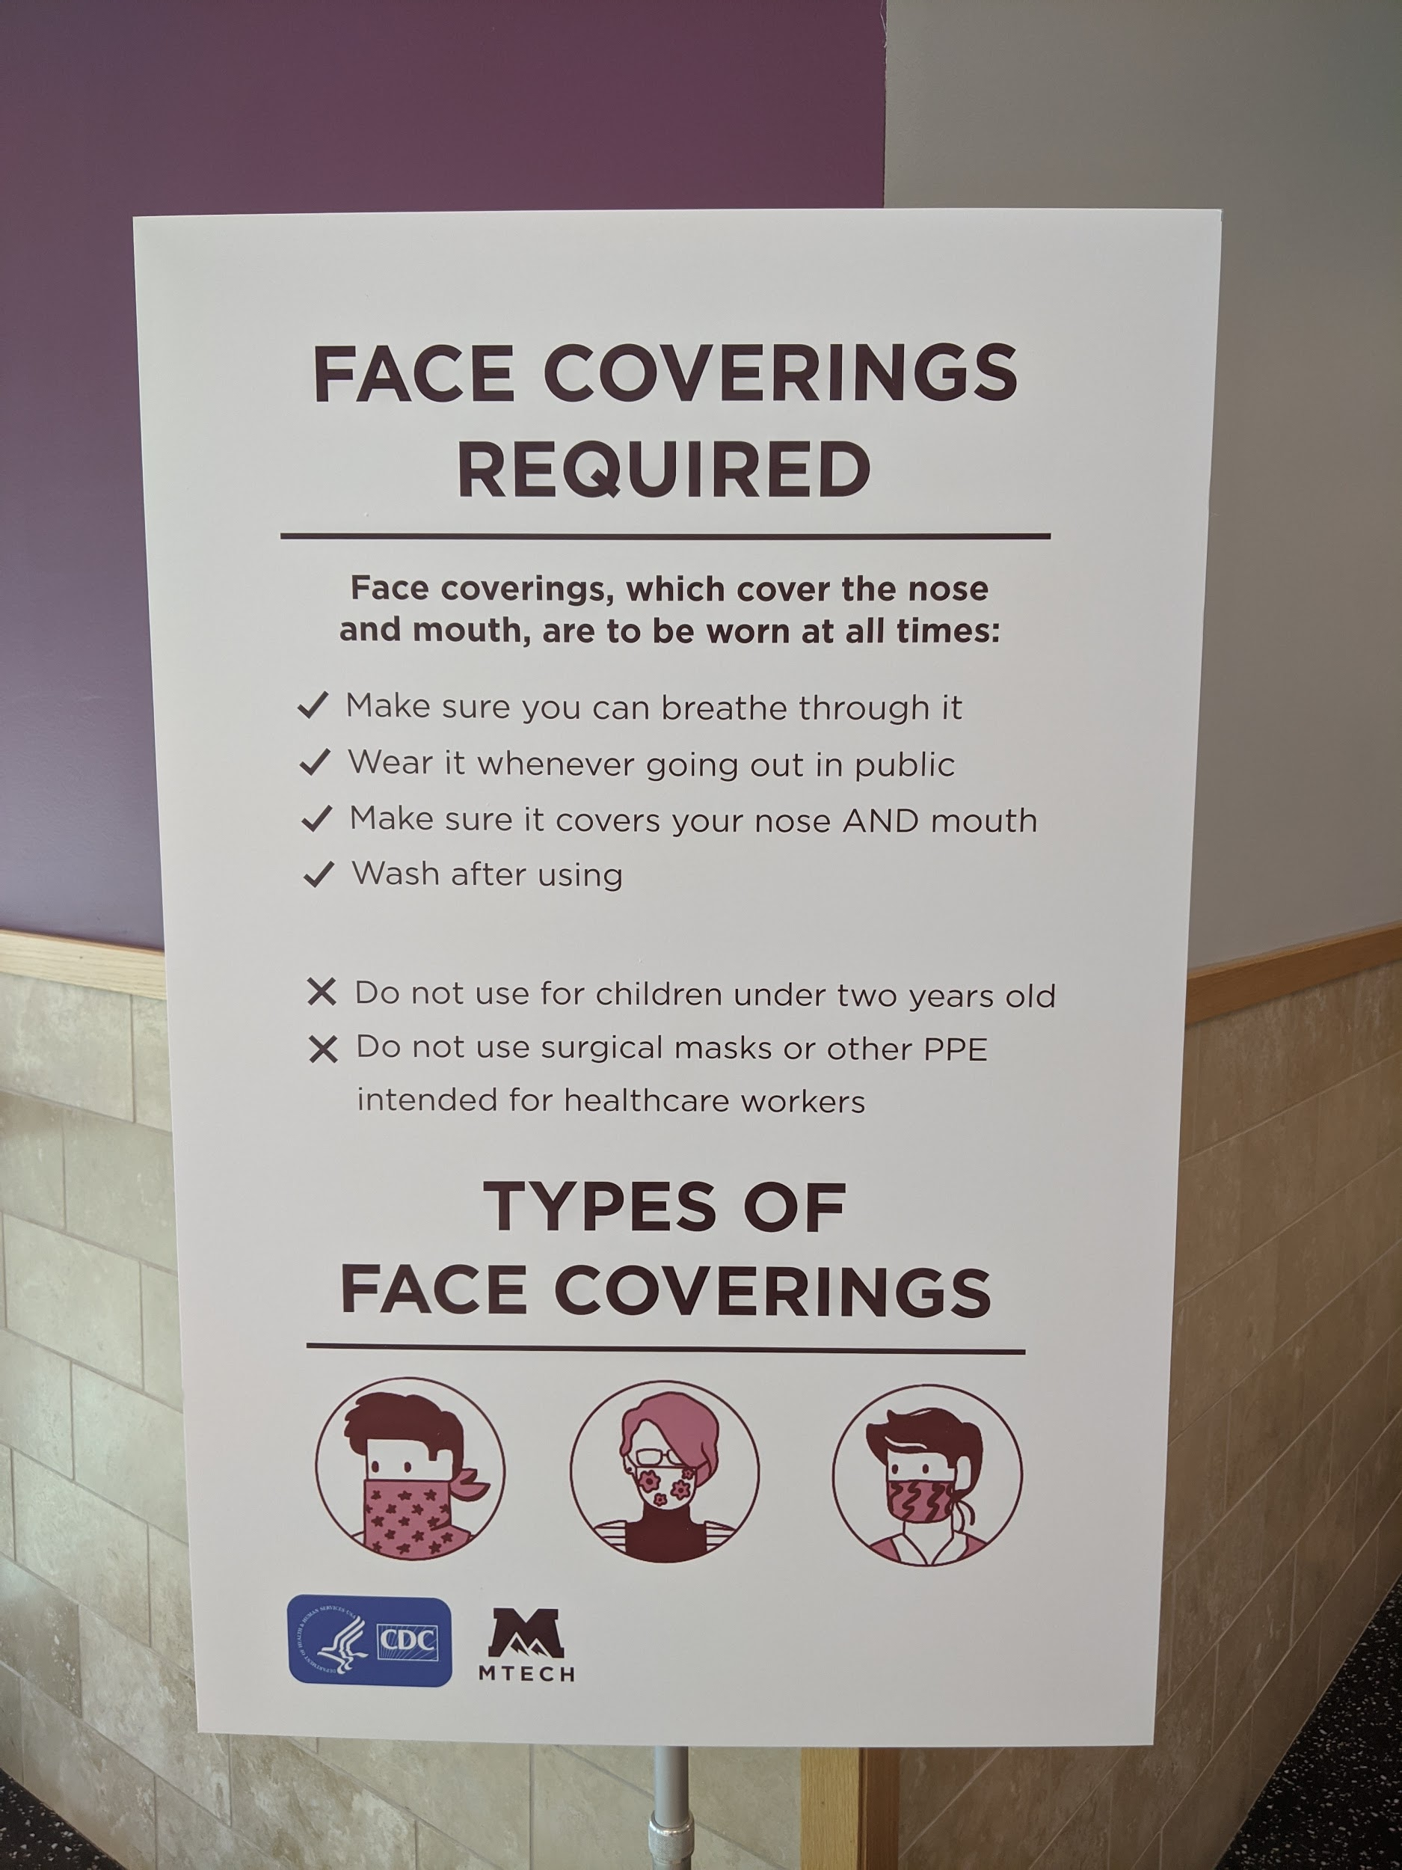
MTECH Re-Opening Protocols
Everyone (Students, Faculty, Administration, Staff, & Visitors)
entering an MTECH facility, consistent with CDC
recommendations, is expected to accommodate
the following:
Face coverings, which cover the nose and mouth,
are to be worn at all times (masks provided by school)
Maintain social distancing of at least six (6) feet
Temperature check-in stations, started in June, were discontinued on August 3, 2020

Slide 6
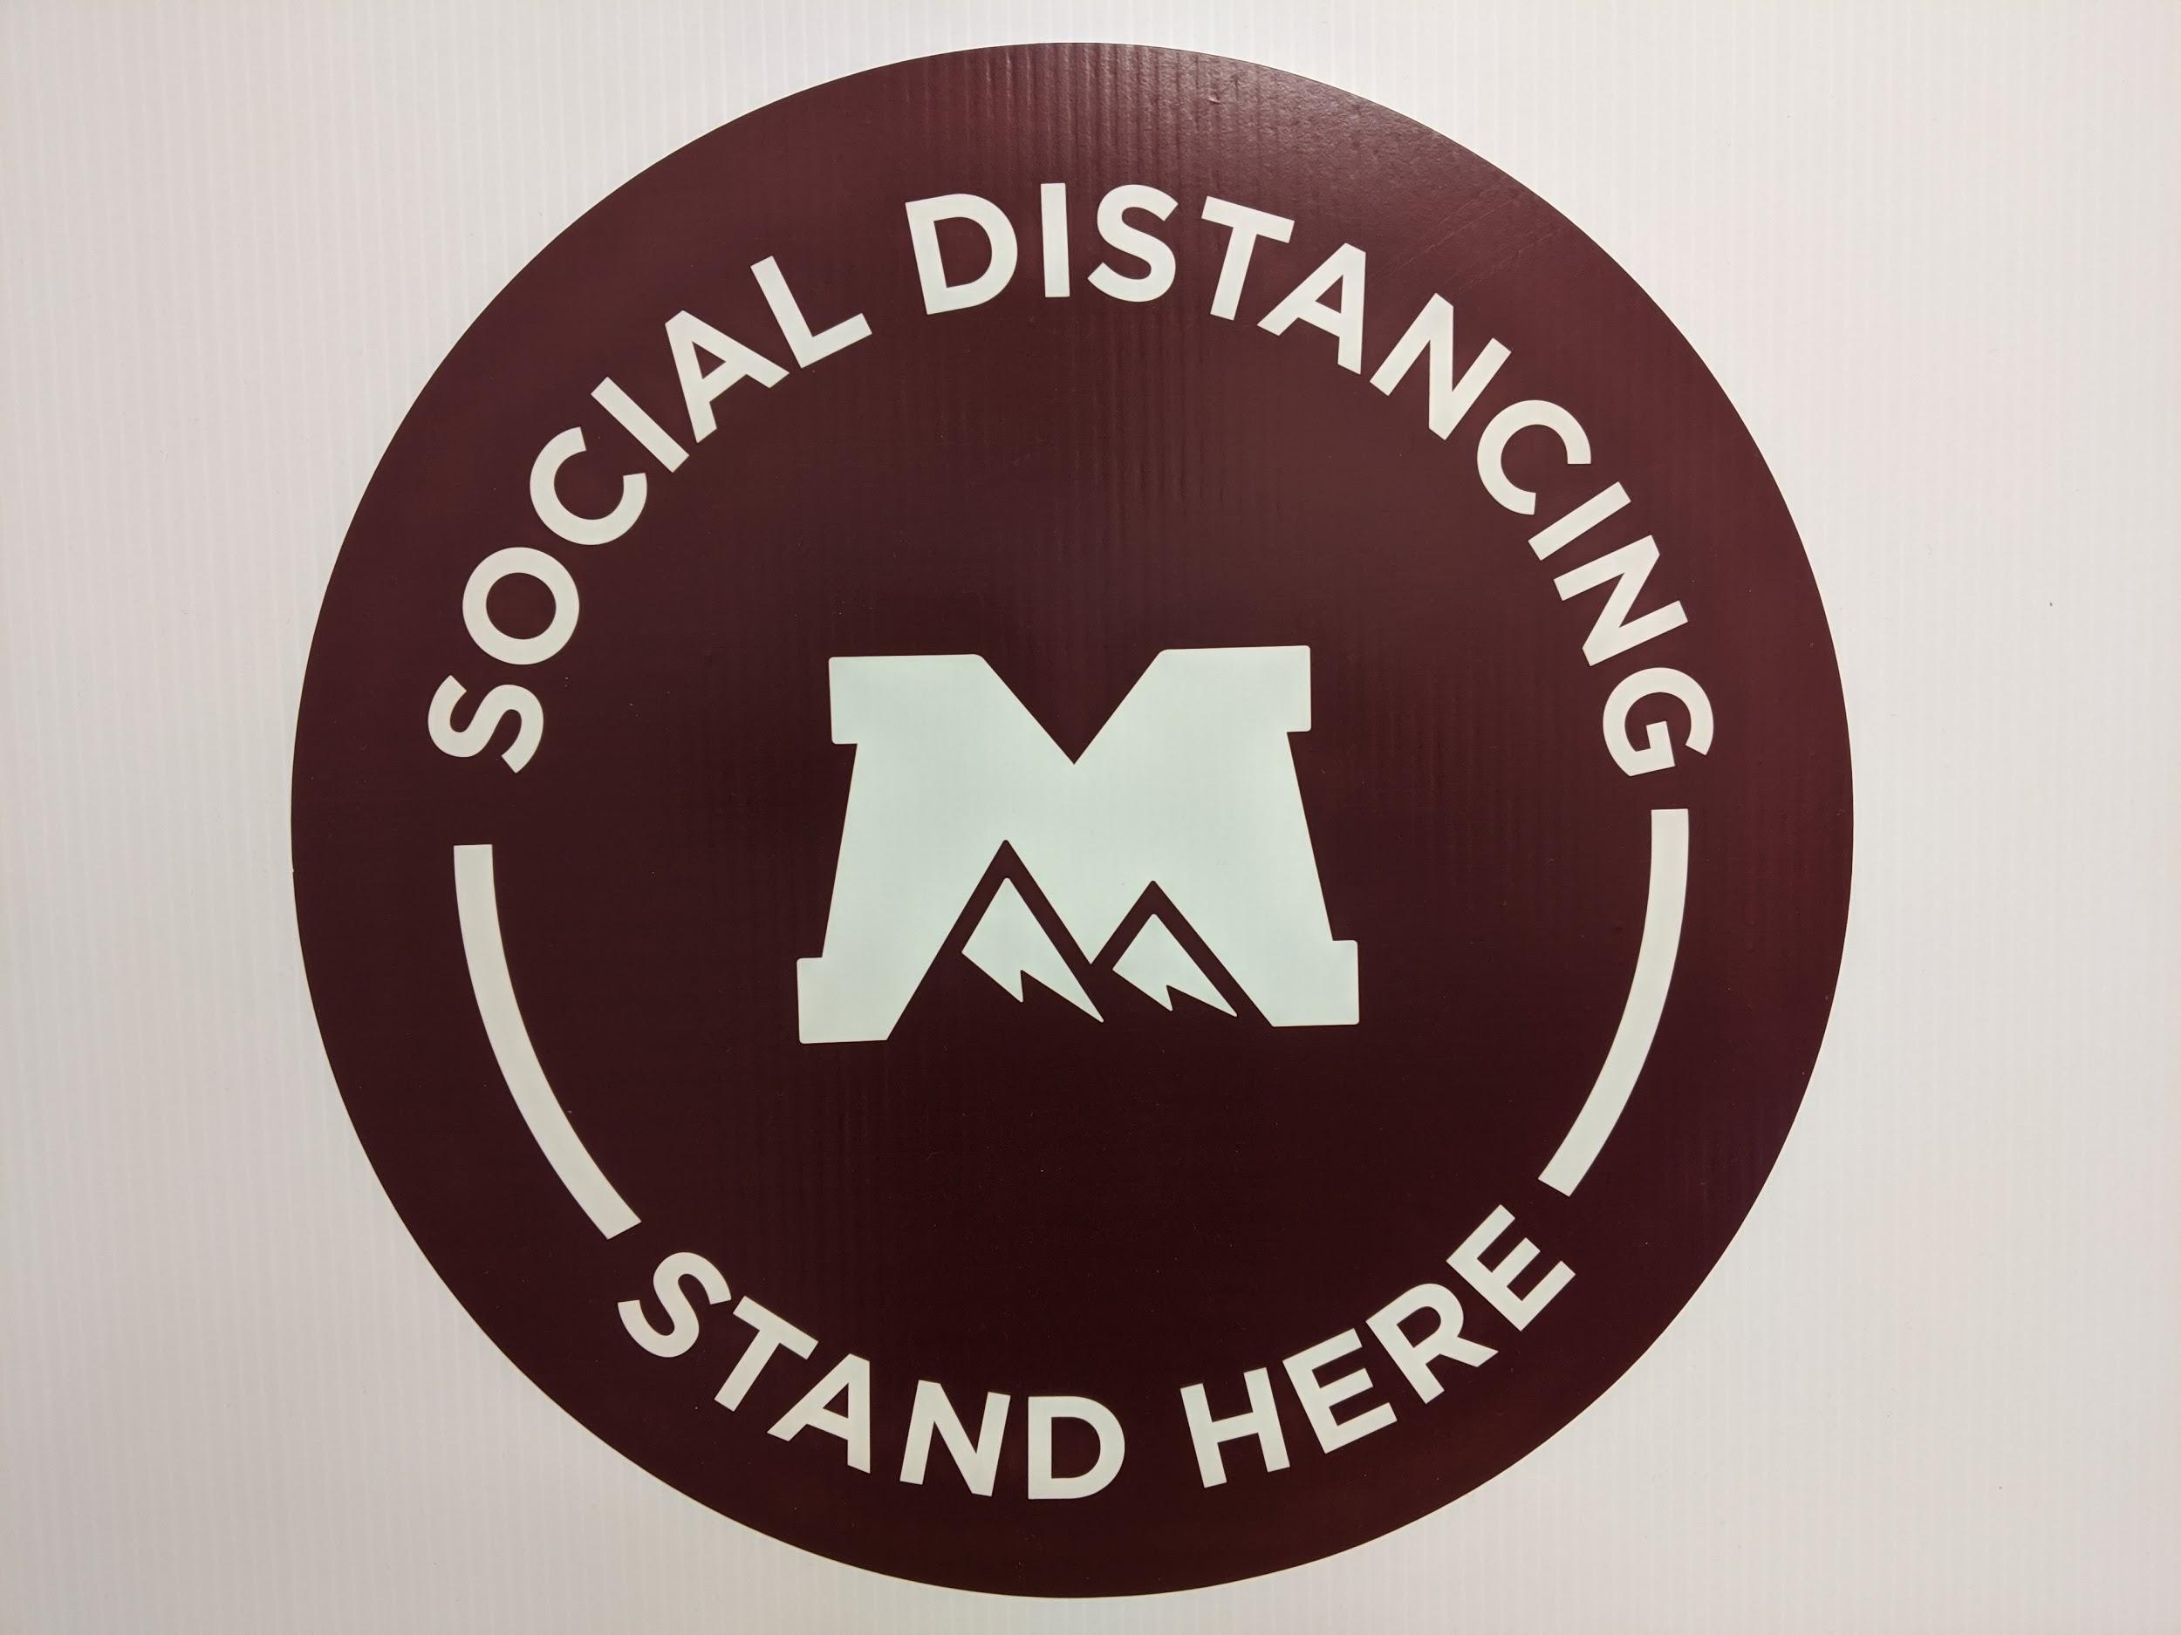
MTECH Re-Opening Protocols, cont.
Facility Cleanliness Management, as of June 1, 2020
MTECH takes extra precautions and preventive measures in following the CDC’s recommendations on daily cleaning and disinfecting our campuses to help protect students, staff, and faculty against the Coronavirus/COVID-19.

Slide 7
MTECH Re-Opening Protocols, cont.
Employee Expectations, as of June 1, 2020
In addition to complying with College requirements of face coverings and social distancing, all employees will:
Monitor and encourage adherence to all policies, including face coverings.
Clean class/work-area above and beyond that of the facilities team.
Report any issues of non-compliance with any school policy to administration or, based on the severity of the situation, law enforcement.
Direct any student or visitor experiencing coronavirus symptoms to the Health Department (information posted throughout the facilities).

Slide 8
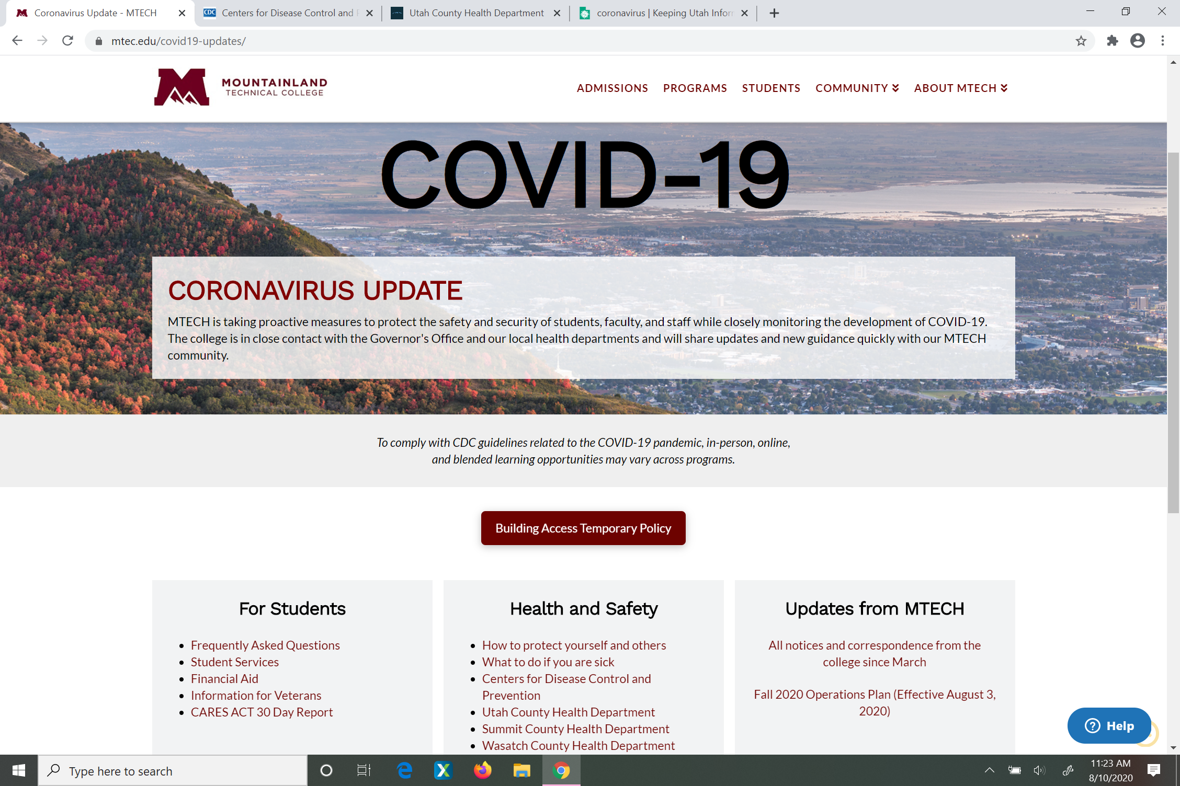
Clear & Consistent Communication
16 Direct Messages from Office of the President to students, faculty, and staff
Real-time updates posted to the Web and connected through social media
Online Town Hall / Q&A Session
Federal, State, and Local authorities and health agencies

Slide 9
Lessons Learned from COVID-19
No plan is perfect or fixed
Sound decisions require thoughtful input from stakeholders and healthcare experts
Clear, consistent, communication is key
Students, Staff, & Faculty deserve leadership focused on their health and safety
MTECH is better prepared today than yesterday or in March 2020

Slide 10
MTECH Supports Utah’s Economic Recovery
Full offering of Programs
Learn and Work in Utah Scholarship Grant
Staff and Faculty excited to serve and deliver world-class education expected from MTECH

Slide 11
Thank you for your support!

