Slide 1
Creative Ways to Cut Costs

Slide 2
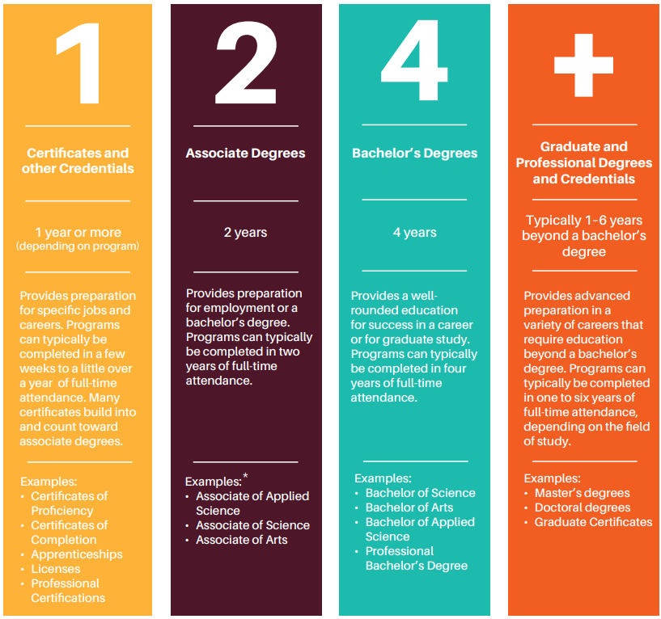
What is college?
Any postsecondary education (after high school)
Technical college
Community college
University
Types:
Certificates and other credentials
Associate degrees
Bachelor’s degrees
Graduate and professional degrees
Notes:
The word college includes a student earning a certificate at a technical college, an associate’s degree, a bachelor’s degree or a graduate professional degree. The image on your screen is an excerpt from the Utah College Guide, page 4, that talks about post-secondary options as 1,2,4 or more. In other words, high school is not enough in today’s economy. And that most jobs today require a college education beyond an HS diploma. Essentially, we want students to know their options post-high school for success in life and the workplace.

Slide 3
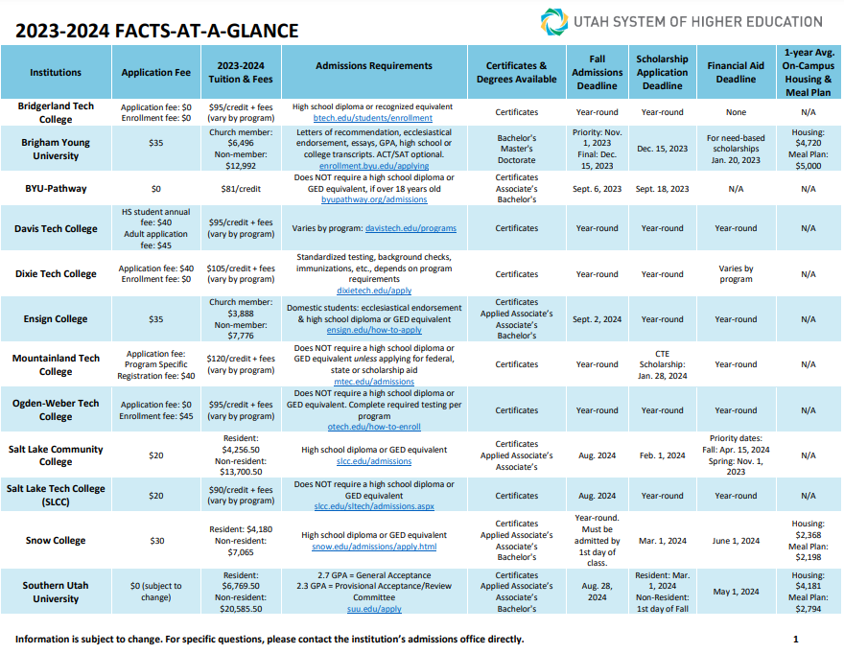

Slide 4
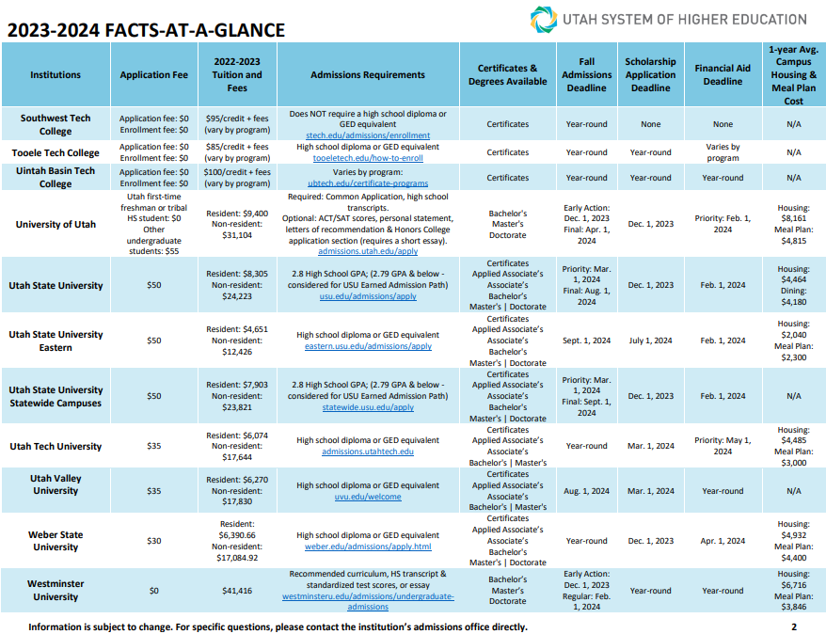

Slide 5
Paying For College Student Bundle
File the FAFSA
Earn and Save
Apply for Scholarships
Paying for College Student Bundle
Individual Student Situations
Creative Ways to Cut Costs
Notes:
The first three sections are the main ways to pay for college, let’s now talk about some alternative ways to afford college by cutting costs.

Slide 6
Plan ahead and save more
It’s possible to lower out-of-pocket costs for college by planning ahead and learning about higher education options available in Utah.
It can be as simple as earning good grades to qualify for scholarships, or volunteering in the community.
Click the icons to watch the video

Slide 7
High School Students
A+
Increase GPA by earning good grades. Stay focused, and study
Take the ACT/SAT exams more than once to earn a higher score
Pro-Tip: Focus on a different subject each time to increase the score in each category. The highest score of each category is used for what colleges are looking for, not the best score from one exam.
Volunteer
Volunteer in the community, or participate in school leadership, clubs, or extracurriculars like intermural sports or performing arts
1, 2, 4, or more (right college fit)
Not all college degrees require a four-year commitment or more. There are technical certifications and associate degrees offered by Utah colleges that can equate to one to two-year programs, depending on the field of study.
Notes:
Higher GPA and standard testing can lead to more or better scholarship opportunities.
Taking college courses in high school can save you costs of those courses later.
Getting involved can help you become a better scholarship candidate and may open doors to scholarship opportunities.
Finding the right fit can save you time and money in the long run. It avoids restarting new programs, taking classes that are no longer applicable, and can put you on the right track upfront. However, some students need to explore programs before finding the right fit.

Slide 8
High School Students
Earn college credit in high school by participating in these programs:
Concurrent Enrollment (CE)
Advanced Placement (AP)
International Baccalaureate (IB)
Dual Enrollment classes at a technical college
Notes:
Concurrent Enrollment (CE)
Concurrent enrollment provides an opportunity for high school juniors and seniors to earn college credit at Utah colleges while still in high school.
Advanced Placement (AP)
Students who take an Advanced Placement course through their high school can register for the corresponding AP test and earn college credits. More information is available on the official AP website. To see how test scores are applied at public colleges and universities in Utah, use the Credit by Examination table. See resources below.
International Baccalaureate (IB)
The International Baccalaureate is an internationally accepted qualification program for students who have completed a specific two-year high school curriculum and demonstrated competency through exams in languages, experimental sciences, social sciences, and mathematics. More information is available on the International Baccalaureate website. To see how test scores are applied at public colleges and universities in Utah, use the Credit by Examination table. See resources below.
Dual Enrollment classes at a technical college
Sign up for dual enrollment to earn credits toward a technical degree while completing a high school diploma at the same time.

Slide 9
College Students
Housing: To reduce housing expenses, consider living at home or with roommates to save on on-campus housing
Textbooks: Save on textbooks by renting or buying used copies. Students can also use the library reserve as an alternative to brand-new textbooks.
Take advantage of plateau tuition
Plateau tuition – or “banded” tuition – is a set tuition price for undergraduate students within a set range of credits. In other words, at almost all Utah colleges, it is the same tuition and fees for students to take 15 credits a semester as it is for them to take 12.
Earn credits to graduate on time
Notes:
Not taking enough credits could cause you to be required to take an additional semester or more just to graduate, talk with your academic adviser at the college to make sure you are on track.
Resident assistance can earn free housing, a stipend, or a paycheck depending on the situation and college.
Students get so many discounts for being enrolled, explore deals on food, car maintenance, insurance, transportation, activities, music, internet, media, and more.
Transportation can be costly depending on your situation, see if your college give free access to public transportation or other means of travel.

Slide 10
College Students
Become a resident assistant for on-campus housing and save on tuition or consider running for student leadership positions that offer scholarships. Becoming a presidential ambassador can also be beneficial for some students.
Research and ask about student discounts out and around town
See if your college provides transportation benefits which can reduce transportation and commuter expenses
Consider the Western Undergraduate Exchange (WUE) by WICHE if attending college out-of-state
Through the WUE program, students enroll in colleges or universities outside their home state and pay no more than 150% of that institution’s resident tuition rate. Since nonresident tuition can cost 300% (or more) of resident rates, the WUE discount saves students $9,000 a year on average.
Notes:
Housing and textbooks can be huge money savers if you do it right.
Presidential ambassadors can earn a stipend, tuition reduction, or a paycheck.
Banded tuition can be beneficial in where you choose to go.
Explore options for the Western Undergraduate Exchange here: https://www.wiche.edu/tuition-savings/wue/

Slide 11
Paying For College Student Bundle
File the FAFSA
Earn and Save
Apply for Scholarships
Paying for College Student Bundle
Individual Student Situations
Creative Ways to Cut Costs

Slide 12
Questions?
Contact Information

Slide 13
Video Resources
Concurrent Enrollment Saves Time and Money
https://youtu.be/byCK_Ap5eT4
Tips for Cutting College Costs
https://youtu.be/I2mAPjVmvGM

