Slide 1
Earn and Save

Slide 2
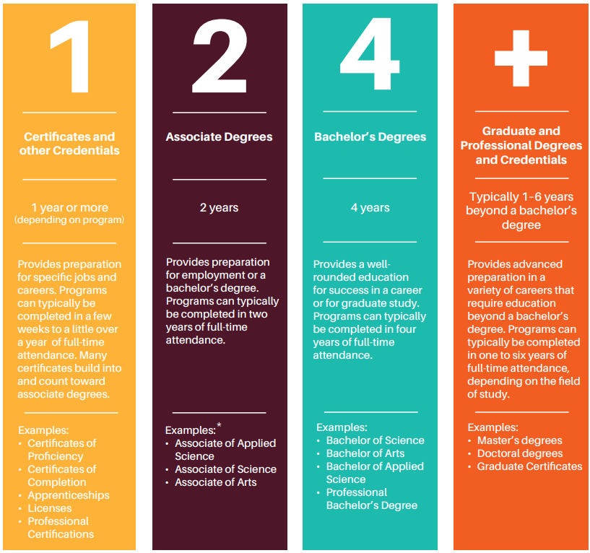
What is college?
Any postsecondary education (after high school)
Technical college
Community college
University
Types:
Certificates and other credentials
Associate degrees
Bachelor’s degrees
Graduate and professional degrees
Notes:
The word college includes a student earning a certificate at a technical college, an associate’s degree, a bachelor’s degree or a graduate professional degree. The image on your screen is an excerpt from the Utah College Guide, page 4, that talks about post-secondary options as 1,2,4 or more. In other words, high school is not enough in today’s economy. And that most jobs today require a college education beyond an HS diploma. Essentially, we want students to know their options post-high school for success in life and the workplace.

Slide 3
How much does college cost?
2022 Average Utah In-State Tuitions and Fees
Technical College | ~$95/credit + fees
2-Year College | $3,173
4-Year University | $6,921
2022 Average National Out-Of-State Tuitions and Fees
Nationwide Colleges and Universities | $26,382
2021 Average National Private Non-Profit Tuitions and Fees
2-Year College | $18,000
4-Year University | $37,600
*Don’t forget external costs – Food, housing, books, supplies, transportation, etc.
Notes:
The basic impression in this slide is
to get students to think about how much college is going to cost and
that if they are looking for the most affordable option that public in-state colleges are going to be the most affordable choice.

Slide 4
Paying For College Student Bundle
File the FAFSA
Earn and Save
Apply for Scholarships
Paying for College Student Bundle
Individual Student Situations
Creative Ways to Cut Costs
Notes:
The third step to paying for college is working and saving.

Slide 5
Earn and Save

Slide 6
Consider Working While in College
Work-Study Programs
Internships
Part-Time Employment
Summer or Seasonal Jobs
Work-study jobs, part-time employment, seasonal roles, and internships all offer opportunities to learn and grow outside of the classroom while earning a degree.
Click the icons to watch the video
Notes:
These are some of the most common ways to work, but are not limited to these.

Slide 7
Federal Work-Study Programs
Work study is a part-time position, usually offered on campus. Many work-study jobs offer flexible schedules around classes and exam calendars and can help build connections with faculty and peers.
Work-Study Job Opportunities:
Student Center Role
Research Assistant
Off-Campus Position
Fitness Center Position
Library Support Role
Notes:
Details about Work-Study is in the yellow “File the FAFSA” section near the end.

Slide 8
Part-Time Employment
Students can be more successful in education when working part-time compared to working full-time.
Balancing work and academics can be a challenge, but it’s important to make studying a priority.
Seek opportunities that align with your interests and career goals! They may provide valuable experiences and connections.
Here are some questions to ask when looking for employment and earning your degree at the same time:
Will this job bring me closer to my goal of graduation?
Will I be able to manage the work-load along with school?
Is this job getting me experience and networking opportunities in my field of study?
Notes:
It is recommended to work part-time while studying than to work full-time.

Slide 9
Summer and Seasonal Jobs
One of the best ways to save for school is by taking advantage of working full-time during seasonal breaks, during the summer or winter.
Explore seasonal employment opportunities, like:
Summer programs
Become a lifeguard, camp counselor, or outdoor guide
Retail opportunities
Hospitality positions in restaurants, hotels, etc.
Check local listings for options in the community.
Notes:
This option is specifically when school is not in session but not limited to those times.

Slide 10
Internships
Internships are professional learning experiences that give students exposure to a business or organization related to the student’s field of study.
Internships can be a good way to gain:
Hands-on experience
Resume-building assets
Networking opportunities
Credits to graduate (required by some programs)
Monetary compensation (sometimes)
Notes:
Please make students aware that not all internships pay, in fact, most don’t. However, there are many benefits to doing an internship and it may be required to complete a class or graduate.

Slide 11
Saving Options
Bank or Credit Union | my529 | ABLE Account
Earns interest | Investment account Visit my529.org for information on Utah’s plan Short video - https://youtu.be/tur4nwALKJE | Investment account, but for qualified disability expenses ableut.com stableaccount.com
Notes:
Saving options are not limited to these three options, these are just the most recommended. ABLE or STABLE accounts are specific to students with disabilities only.

Slide 12
Students with Disabilities
Notes:
Seniors, how many of you have completed the FAFSA?
How many plan on doing it?

Slide 13
Modifications vs. Accommodations
Modifications: K-12
Accommodations: Higher Education
Modifications are made to assignments and the curriculum to meet the Free Access to Publication Education, also known as FAPE, requirements in secondary education
E.g., reduced number of questions on assignments, reduction topics covered in class, use a word list or list of math formulas
Accommodations are made on college campuses to create accessibility for students with disabilities, but adjustments aren’t made to the course requirements or the curriculum
E.g., specialized tutoring, recorded/audiobooks, class notetakers, preferential seating, lecture notes, study guides, etc.
Source: https://www.parentcenterhub.org/accommodations/
Notes:
Modifications and Accommodations are VERY different.

Slide 14
FERPA form - Student Information Release Form
“FERPA gives parents certain rights with respect to their children's education records. These rights transfer to the student when he or she reaches the age of 18 or attends a school beyond the high school level.” – U.S. Department of Education
The student needs to request the FERPA form. A parent cannot.
The student must agree to who is listed as the recipient in order to release records if it’s an individual other than the student with access to records
This can be beneficial if the student is deferring enrollment or taking a gap year
e.g., military service, ecclesiastical mission, humanitarian service, etc.
Remember that if you want a trusted adult involved in your college information, meetings, and conversations, you should want this form signed
Source: https://www2.ed.gov/policy/gen/guid/fpco/ferpa/index.html
Notes:
In short, if the parent wants access to see the students tuition, fees, grades, etc., they will need to get permission from the student and that student must sign a student information release form. Otherwise the parent will be cut off from any information regarding the student’s education.

Slide 15
Institution Disability Resource Centers
Public Colleges and Universities
Private Institutions

Slide 16
Paying For College Student Bundle
File the FAFSA
Earn and Save
Apply for Scholarships
Paying for College Student Bundle
Individual Student Situations
Creative Ways to Cut Costs

Slide 17
Questions?
Contact Information

