Slide 1
Creative Ways to Cut College Costs
Cut Costs Handout
College Benefits Bingo Activity
Cut Costs YouTube or Video Downloads

Slide 2
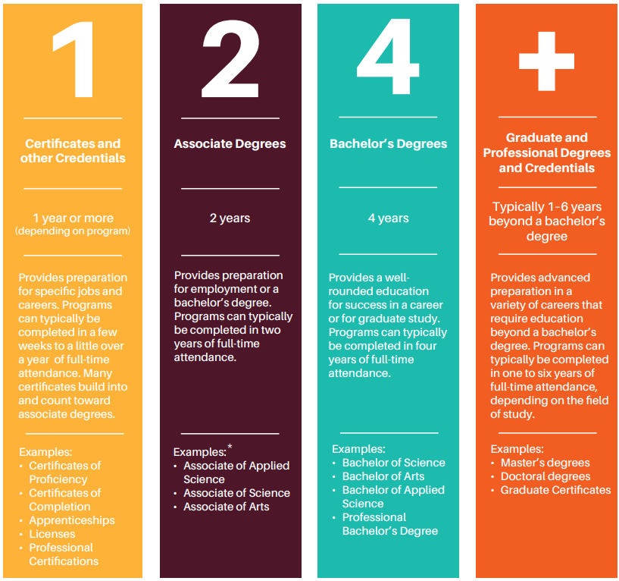
What is college?
Any postsecondary education (after high school)
Technical college
Community college
University
Types:
Certificates and other credentials
Associate degrees
Bachelor’s degrees
Graduate and professional degrees

Slide 3
How much does college cost?
Click for College Costs YouTube Videos
2024 Average Utah In-State Tuition and Fees (per year)
Public Technical College | ~$99/credit + fees
2-Year Public College | $4,382
4-Year Public University | $7,531
2024 Average National Out-Of-State Tuitions and Fees (per year)
National 2-Year Public College | $8,415
National 4-Year Public University | $27,457
2024 Average National Private Non-Profit Tuitions and Fees (per year)
National 2-Year Non-Profit Private College | $20,019
National 4-Year Non-Profit Private University | $38,421
*These costs don’t include external costs – Food, housing, books, supplies, transportation, etc.

Slide 4
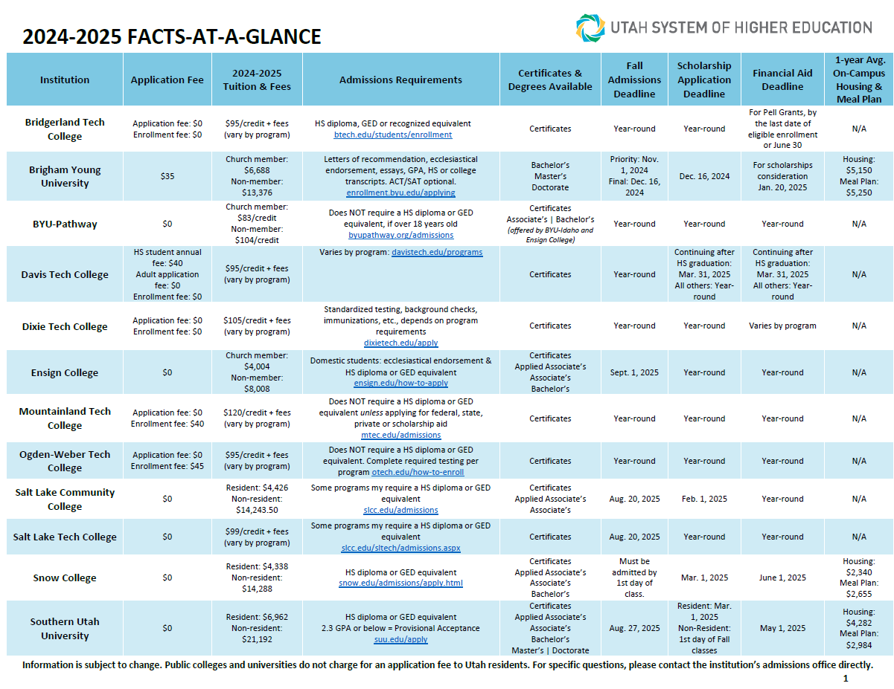

Slide 6
Paying for College Student Bundle
File the FAFSA
Earn and Save
Apply for Scholarships
Paying for College Student Bundle
Individual Student Situations
Creative Ways to Cut Costs

Slide 7
Plan ahead and save more
Lowering out-of-pocket costs for college is possible by planning ahead and researching higher education options available in Utah.
Simple steps such as earning good grades to qualify for scholarships or volunteering in the community can make a difference.

Slide 8
While in high school
A+
Increase GPA by earning good grades. Stay focused and study.
Take the ACT/SAT exams multiple times to improve your score
Pro-Tip: Focus on a different subject each time to improve scores in each category. Colleges consider the highest score in each category rather than the best overall score from a single exam
Volunteer
Volunteer in the community or participate in school leadership, clubs, or extracurricular activities like intramural sports or performing arts
Explore UServe.utah.gov for different volunteer opportunities in Utah
1, 2, 4, or more (choose the right college fit)
Not all college degrees require a four-year commitment. Utah colleges offer technical certifications and associate degrees that can be completed in one to two years, depending on the field of study

Slide 9
While in high school
Earn college credit in high school by participating in these programs:
Concurrent Enrollment
Advanced Placement
International Baccalaureate
Dual Enrollment at a technical college
(CE)
(AP)
(IB)
(DE)

Slide 10
College prep and attendance
Housing: Consider living at home or with roommates to reduce housing expenses and save on on-campus housing costs.
Take advantage of plateau tuition: Plateau tuition – also known as "banded" tuition – offers a set tuition price for undergraduate students within a specific range of credits. At almost all Utah colleges, students pay the same tuition and fees whether they take 15 credits a semester or 12.
Student involvement and leadership:
Apply to be a presidential ambassador for tuition benefits and leadership opportunities
Consider running for student leadership positions that offer scholarships or tuition stipends
Become a resident assistant for on-campus housing

Slide 11
College prep and attendance
Textbooks: Save on textbooks by renting or purchasing used copies and utilize the college’s library reserve as an alternative to buying brand-new textbooks.
Earn credits to graduate on time: Ensure taking enough credits each semester to graduate on time to avoid additional costs for additional semesters.
Student discounts: Research and inquire about student discounts around town.
Transportation: Check if your college provides transportation benefits, which reduce transportation and commuter expenses.

Slide 12
College prep and attendance
Out-of-state savings: Consider the Western Undergraduate Exchange (WUE) by WICHE if attending college out-of-state.
Through the WUE program, students enroll in colleges or universities outside their home state and pay no more than 150% of that institution’s resident tuition rate. Since nonresident tuition can cost 300% (or more) of resident rates, the WUE discount saves out-of-state students an average of $9,000 a year.

Slide 13
Students Who Are Citizens/Members of Federally Designated Native American Tribes
Tribal Citizen/Member Handout

Slide 14
Students Who Are Citizens/Members of Federally Designated Native American Tribes
In-State Tuition Residency Tribal Access
Board Policy R512, Resident Student Status:
https://public.powerdms.com/Uta7295/tree/documents/2022238
In-state tuition may be available to American Indians if they meet the following criteria for resident student status:
They are enrolled on the tribal rolls of a tribe whose reservation or trust lands lie partly or wholly within Utah or whose border is at any point contiguous with the border of Utah; or
They are a member of a federally recognized or known Utah tribe and has graduated from a Utah high school.
For more details talk to your college’s residency office

Slide 15
Paying for College Student Bundle
File the FAFSA
Earn and Save
Apply for Scholarships
Paying for College Student Bundle
Individual Student Situations
Creative Ways to Cut Costs

Slide 16
Questions

