Slide 1
Earn and Save
Earn and Save Handout
Resume Builder Activity
My529 Exploration Activity
Earn and Save YouTube or Video Downloads

Slide 2
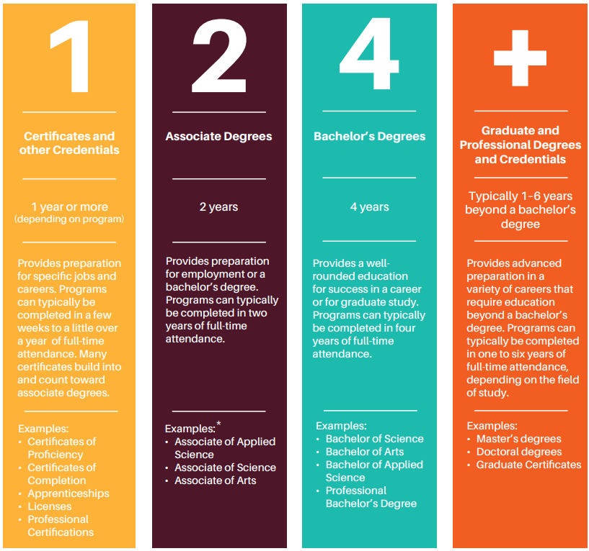
What is college?
Any postsecondary education (after high school)
Technical college
Community college
University
Types:
Certificates and other credentials
Associate degrees
Bachelor’s degrees
Graduate and professional degrees

Slide 3
How much does college cost?
Click for College Costs YouTube Videos
2024 Average Utah In-State Tuition and Fees (per year)
Public Technical College | ~$99/credit + fees
2-Year Public College | $4,382
4-Year Public University | $7,531
2024 Average National Out-Of-State Tuitions and Fees (per year)
National 2-Year Public College | $8,415
National 4-Year Public University | $27,457
2024 Average National Private Non-Profit Tuitions and Fees (per year)
National 2-Year Non-Profit Private College | $20,019
National 4-Year Non-Profit Private University | $38,421
*These costs don’t include external costs – Food, housing, books, supplies, transportation, etc.

Slide 4
Paying for College Student Bundle
File the FAFSA
Earn and Save
Apply for Scholarships
Paying for College Student Bundle
Individual Student Situations
Creative Ways to Cut Costs

Slide 5
Consider working while in college
Work-Study Program
Part-Time Employment
Work-study jobs, part-time employment, seasonal roles, and internships all offer opportunities to learn and grow outside of the classroom while earning a degree.
Summer or Seasonal Jobs
Internships

Slide 6
Federal Work-Study program
Work-study is a part-time position typically offered on campus. Many work-study jobs provide flexible schedules around classes and exam calendars and can help build connections with faculty and peers.
Work-Study Job Opportunities:
Student Center Roles
Research Assistantships
Off-Campus Positions
Fitness Center Positions
Library Support Roles

Slide 7
Part-time employment
Students can often achieve greater success in their education when working part-time rather than full-time.
Balancing work and academics can be challenging, but prioritizing studying is crucial.
Seek opportunities that align with your interests and career goals, as they can provide valuable experiences and connections.
Questions to ask when seeking employment and earning your degree:
Will this job bring me closer to my goal of graduation?
Can I manage this workload alongside my studies?
Does this job offer experience and networking opportunities in my field of study?

Slide 8
Summer and seasonal jobs
One of the best ways to save for college is to work full-time during seasonal breaks, like the summer or winter.
Explore seasonal employment opportunities, such as:
Summer programs
Lifeguarding, camp counseling, or outdoor guiding
Retail positions
Hospitality roles in restaurants, hotels, etc.
Check local listings for options in the community

Slide 9
Internships
Internships are professional learning experiences that give students exposure to businesses and organizations relevant to their field of study.
Internships offer:
Hands-on experience
Resume-building assets
Networking opportunities
Credits towards graduation for some programs
Some offer monetary compensation

Slide 10
Saving options
Bank or Credit Union | my529 | ABLE Account
Earns interest | Investment account Visit my529.org for information on Utah’s plan | Investment account, but for qualified disability expenses ableut.com stableaccount.com
Click for my529 video

Slide 11
Students with Disabilities
Students with Disabilities Handout

Slide 12
Modifications vs. Accommodations
Modifications: K-12
Accommodations: Higher Education
Modifications are made to assignments and the curriculum to meet the Free Appropriate Public Education (FAPE) requirements in secondary education
Examples include:
Reduced number of questions on assignments
Fewer topics covered in class
Use of a word list or list of math formulas
Accommodations are made on college campuses to create accessibility for students with disabilities, but adjustments are not made to the course requirements or the curriculum
Examples include:
Specialized tutoring
Recorded/audiobooks
Class notetakers
Preferential seating
Lecture notes
Study guides
Source: Parent Center Hub

Slide 13
Student Information Release Form (FERPA)
“FERPA gives parents certain rights with respect to their children's education records. These rights transfer to the student when he or she reaches the age of 18 or attends a school beyond the high school level.” – U.S. Department of Education
The student must request the FERPA form. A parent cannot.
The student must agree to who is listed as the recipient in order to release records if it’s an individual other than the student with access to records
This can be beneficial if the student is deferring enrollment or taking a gap year for reasons such as military service, ecclesiastical mission, humanitarian service, etc.
If students want a trusted adult involved with their college information, meetings, and conversations, make sure this form is signed
Source: https://www2.ed.gov/policy/gen/guid/fpco/ferpa/index.html

Slide 14
Institution Disability Resource Centers
Public Colleges and Universities
Private Institutions

Slide 15
Paying for College Student Bundle
File the FAFSA
Earn and Save
Apply for Scholarships
Paying for College Student Bundle
Individual Student Situations
Creative Ways to Cut Costs

Slide 16
Questions

