Slide 1
File the FAFSA
FAFSA Handout
Financial Aid Estimator Activity
FAFSA YouTube or Video Downloads

Slide 2
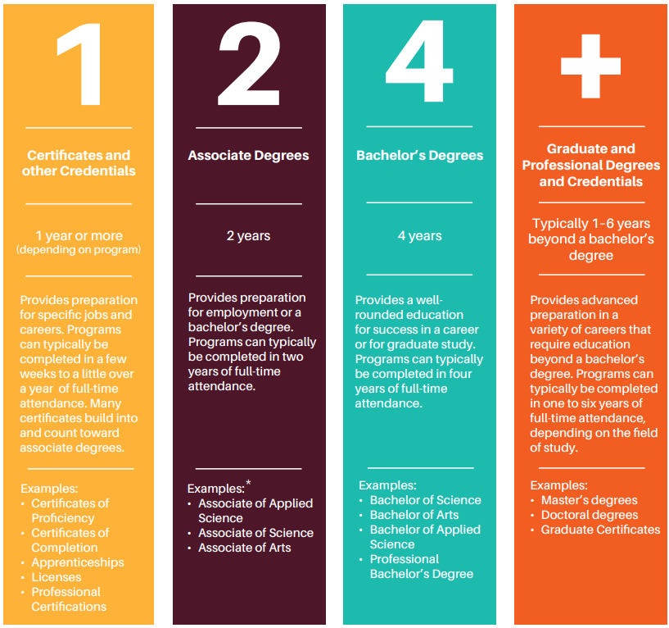
What is college?
Any postsecondary education (after high school)
Technical college
Community college
University
Types:
Certificates and other credentials
Associate degrees
Bachelor’s degrees
Graduate and professional degrees

Slide 3
Paying for College Student Bundle
File the FAFSA
Earn and Save
Apply for Scholarships
Paying for College Student Bundle
Individual Student Situations
Creative Ways to Cut Costs

Slide 4
What is the FAFSA?
It stands for Free Application for Federal Student Aid
FAFSA is the gateway to financial aid and many scholarship opportunities
High school students should start to apply October 1st of their senior year AND every year of college
Go to studentaid.gov to apply!

Slide 5
Why Complete the FAFSA?
Federal Aid
Some Private Scholarships
State Aid & Scholarships
Institutional Aid & Scholarships
Grants
Work-Study
Student Loans
Technical colleges
Community colleges
Universities

Slide 6
What will the FAFSA ask?
The FAFSA attempts to calculate a family’s ability to pay for college. It will ask for:
Demographic information like age and family size
High school information and college interest
Tax information, income, and assets for the student and parent(s)

Slide 7
FAFSA Timeline
Create a studentaid.gov account and complete the FAFSA
(Fall)
If eligible for Work-Study, apply for jobs on campus
(Summer/Year-Round)
Receive, complete, and return the offer letter (Winter/Spring)
1st DAY OF 12th GRADE
1st DAY OF COLLEGE
Complete FAFSA verification
(if selected, Winter/Spring)
For federal loans, complete Entrance Counseling & sign the Master Promissory Note
Accepted aid is automatically disbursed to the college
(At the beginning of each term or semester)

Slide 8
What is the Student Aid Index (SAI)?
Completing the FAFSA generates your SAI
Colleges use the SAI to determine students' eligibility for financial aid
Need = Cost of Attendance (COA) – Student Aid Index (SAI) – Other Financial Assistance (OFA)
A lower SAI indicates higher financial need and provides access to need-based aid
Even with a higher SAI, there are some aid options available. Research alternative ways to pay for college.
Note: Most financial resources require FAFSA completion

Slide 9
What is FAFSA verification?
It is the process of confirming the information provided on the FAFSA
Not everyone is selected for verification
In most cases, verification is processed by the college or university
Verification does not imply that a student is in trouble

Slide 10
What is a financial aid offer letter?
A notification letter sent by the college or university, typically via email or student portal
The letter outlines types and amounts of aid offered:
Federal aid | State aid | Institutional aid
Same amount between colleges | Varies between colleges | Varies between colleges
Use these offers to shop around for the best financial aid

Slide 11
Student loans
All students who complete the FAFSA will be offered a student loan
Loans are not automatically disbursed to a student’s college account
Students must either accept or decline their loan offer
Exhaust all financial resources before accepting a student loan
If a student needs to borrow, they should always accept their subsidized loan first; students are not required to pay interest while they’re in school
OFFER LETTER
Award Type | Fall | Spring | Summer | Total | Action
Direct Subsidized Loan | $1,750.00 | $1,750.00 | $0.00 | $3,500.00 | Decline
Direct Plus Loan | $6,678.00 | $6,678.00 | $0.00 | $13,236.00 | Decline
Direct Unsubsidized Loan | $1,000.00 | $1,000.00 | $0.00 | $2,000.00 | Decline
Federal Pell | $3,697.50 | $3,697.50 | $0.00 | $7,395.00 | Accept
Federal Work Study UG | $300.00 | $300.00 | $0.00 | $600.00 | Accept

Slide 12
What is required after I accept a student loan?
If you borrow federal student loans, you must complete Loan Entrance Counseling and the Master Promissory Note before your loans can be disbursed.
Both processes are online modules that explain the loan terms and conditions, including:
Interest
How to remain eligible for aid
Repayment

Slide 13
What is Work-Study?
A part-time job, typically on-campus, that is federally funded
Positions are usually flexible to accommodate class schedules
Not all students qualify. If eligible, an amount will be included in the offer letter
Students must apply for work-study jobs
Earnings do not affect aid eligibility for future years in college.
Other benefits

Slide 14
FAFSA Timeline
Create a studentaid.gov account and complete the FAFSA
(Fall)
If eligible for Work-Study, apply for jobs on campus
(Summer/Year-Round)
Receive, complete, and return the offer letter (Winter/Spring)
1st DAY OF 12th GRADE
1st DAY OF COLLEGE
Complete FAFSA verification
(if selected, Winter/Spring)
For federal loans, complete Entrance Counseling & sign the Master Promissory Note
Accepted aid is automatically disbursed to the college
(At the beginning of each term or semester)

Slide 15
Who is Eligible to Submit a FAFSA?
Who is Eligible to Submit a FAFSA? Handout

Slide 16
FAFSA citizenship terminology
U.S. Citizens:
Includes naturalized citizens and those born as citizens
U.S. Citizen students are eligible for federal aid from the FAFSA
Eligible Non-Citizens:
Students with documentation that Federal Student Aid considers "eligible" for federal aid
Examples include Permanent Residents (Green Card holders), Refugees, Asylum Grantees, etc.
Neither U.S. Citizens Nor Eligible Non-Citizens:
Students with documentation that Federal Student Aid considers "ineligible" for federal aid, or those without documentation
Examples include students without a Social Security Number (SSN), DACA recipients, TPS recipients, DED recipients, etc.
International Students:
Foreign students attending or planning to attend college in the United States
International students are ineligible for federal aid through the FAFSA

Slide 17
FAFSA eligibility for students with parents without SSNs
Question:
Can a student complete the FAFSA if they are a U.S. citizen or an eligible non-citizen, but their parent does not have a Social Security Number (SSN)?
Answer:
Yes. The student's parent(s) or adoptive parent(s) will need to create a StudentAid.Gov Account and provide consent on the student’s FAFSA to qualify for any aid.
If parents are hesitant about sharing personal information, please know that FAFSA data is protected (encrypted) by federal law and prohibits any use of FAFSA data except to calculate federal and state financial aid.
edtrust.org/the-equity-line/2024-25-better-fafsa-advocacy-faqs/
law.cornell.edu/uscode/text/20/1090

Slide 18
FAFSA eligibility for students considered as an eligible non-citizen
Question:
How can we determine if a student is considered an "eligible non-citizen"?
Can an “eligible non-citizen” complete the FAFSA?
Answer:
Yes. Eligible non-citizens should complete the FAFSA, they are required to provide their "Alien Registration Number" and Social Security Number on the form
Examples of eligible categories include U.S. permanent residents (Green Card holders), refugees, or asylum grantees
Please review what documentation is considered “eligible” by Federal Student Aid on their website:
studentaid.gov/understand-aid/eligibility/requirements/non-us-citizens

Slide 19
Scholarship resources for refugee and asylee students
One Refugee – onerefugee.org
Immigrants Rising – immigrantsrising.org/resource/overview/
University Alliance for Refugees and At-Risk Migrants (UARRM) – uarrm.org/toolkit
Opportunity Scholarship & Financial Aid Estimator - studentaid.gov/aid-estimator/
thedream.us

Slide 20
Funding alternatives for students who are neither U.S. citizens nor eligible non-citizens
Question:
If a student is ineligible for federal student aid (grants, work-study, student loans), what options do they have to pay for college?
Answer:
Private scholarships are always an option
If a student needs to complete the FAFSA to qualify for a scholarship, they should work with their college’s financial aid office or Dream Centers (UofU/SLCC)
In-state tuition may also be an option. Encourage students to inquire with their college or university if they qualify under House Bill 144

Slide 21
Scholarship resources for students who are neither U.S. citizens or eligible non-citizens
University of Utah Dream Center: dream.utah.edu
Salt Lake Community College Dream Center: slcc.edu/dreamcenter/
Utah State University: usu.edu/financial-support/undocumented-student-resources
Weber State University: weber.edu/undocumented/scholarships.html
Utah Tech University: scholarships.utahtech.edu/non-resident-freshman-scholarships-2/
Southern Utah University: https://www.suu.edu/finaid/scholarships.html
Davis Technical College: davistech.edu/scholarships
Utah Valley University: uvu.edu/studentaffairs/initiatives/

Slide 22
Legislation
House Bill (HB) 144 Utah law allows students to pay in-state tuition if the student:
Attended a Utah high school for at least three years
Has a Utah high school diploma or Utah GED
Submit a high school transcript with graduation date listed
Signs and submits an HB 144 affidavit
House Bill (HB) 118
For students who are foreign nationals or legally admitted into the United States with F-1, H-4, or J-1 visas
House Bill (HB) 102
Provides earlier access to in-state tuition depending on the student’s immigration status

Slide 23
FAFSA eligibility for international students
Question:
Can an international student file the FAFSA?
Answer:
Most foreign citizens are not eligible for federal aid and will need a student visa to study in the U.S.
For more information, contact the college's International Student Services office.

Slide 24
Institution International Student Services
Public Colleges and Universities
Private Institutions

Slide 25
Paying for College Student Bundle
File the FAFSA
Earn and Save
Apply for Scholarships
Paying for College Student Bundle
Individual Student Situations
Creative Ways to Cut Costs

Slide 26
Questions

